Slide 1
Generative Information Retrieval
Marc Najork Distinguished Research Scientist, Google DeepMind
SIGIR 2023 keynote 2023/07/24
Notes:
A big thanks to the organizers for inviting me to speak to you today, and thank you all for showing up so early in the day. I suspect that many of you are suffering from a massive jet-lag – I certainly am! I’m Marc Najork, I’m a Distinguished Research Scientist at Google DeepMind, and I would like to tell you today about the emerging field of generative information retrieval.

Slide 2
Disclaimers
This talk reflects my personal opinions
It does not represent Google’s positions on the future of search
It does not foreshadow any future Google products
Most of the work covered in this talk is not mine
Notes:
Before we get started, I would like to provide you with some important disclaimers. First of all, while I work for Google, I cannot speak for the company. Anything I say during this talk is my personal opinion, and none of it should be interpreted as an announcement of any future products of Google or of anyone else, for that matter. Finally, while this talk will touch on some of my own work, the vast majority of research I will cover was done by colleagues at Google or by members of the research community at large, not by me personally. My aim is to paint a picture for you of how our field will evolve from retrieving information to providing answers.

Slide 3
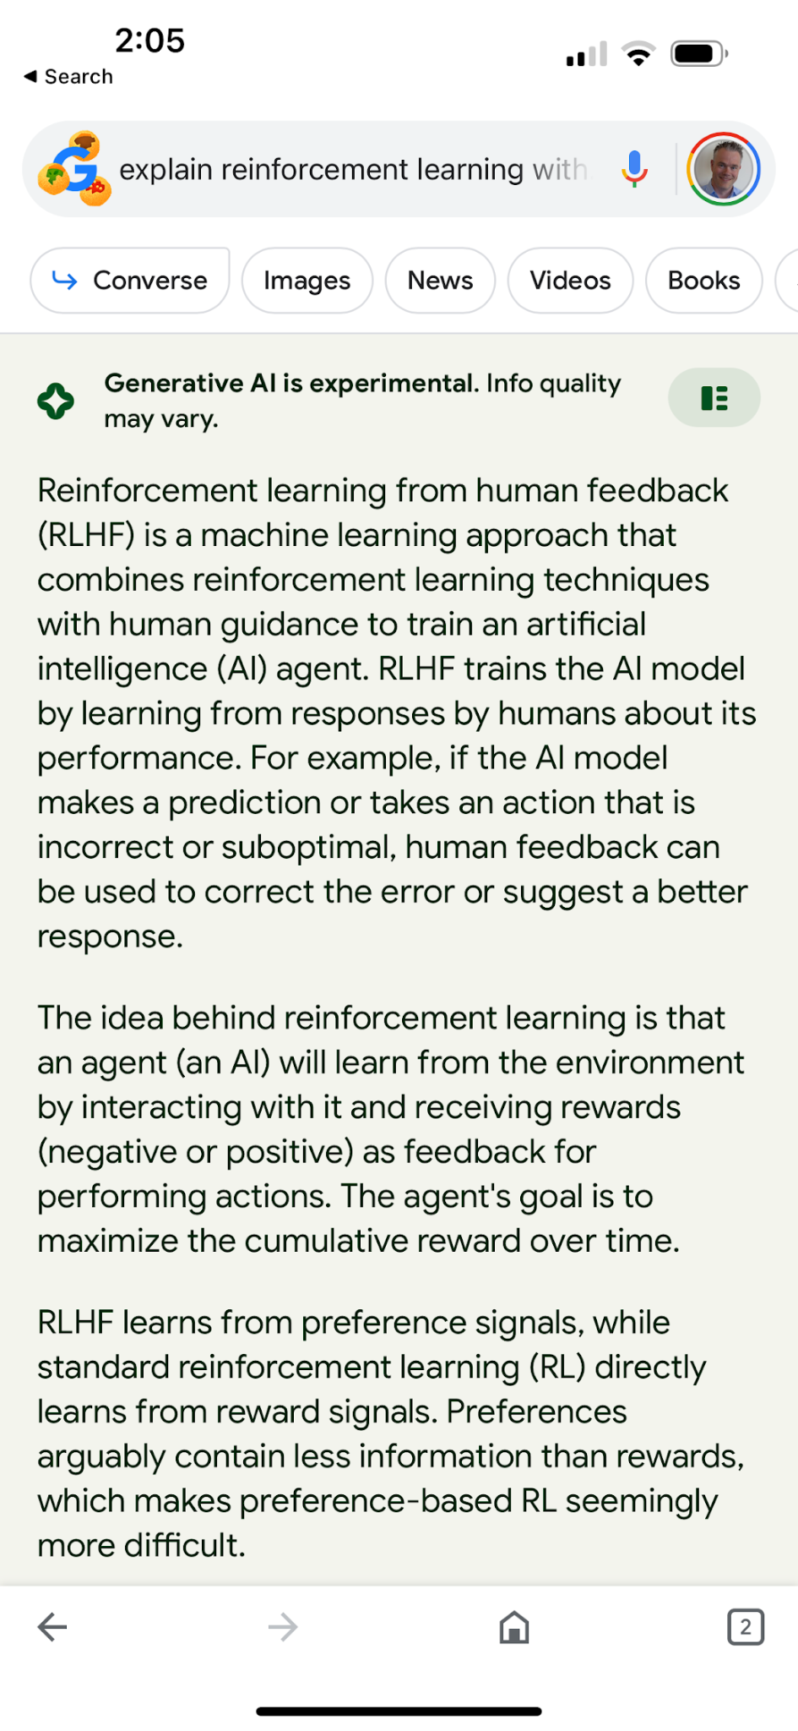
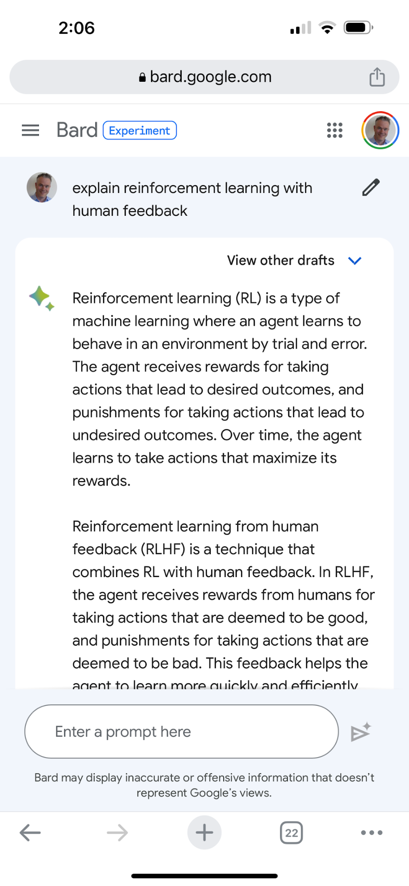
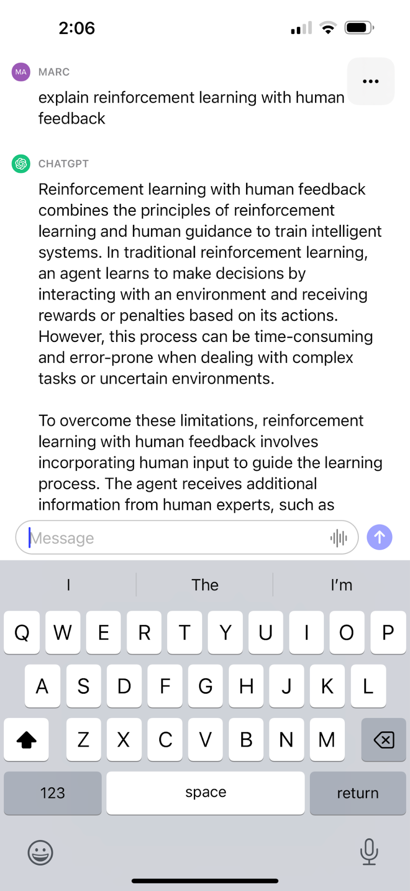
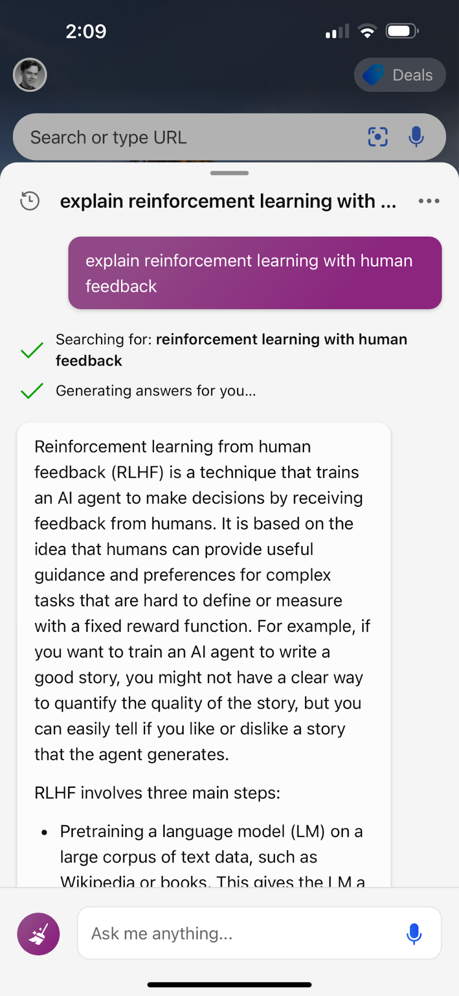
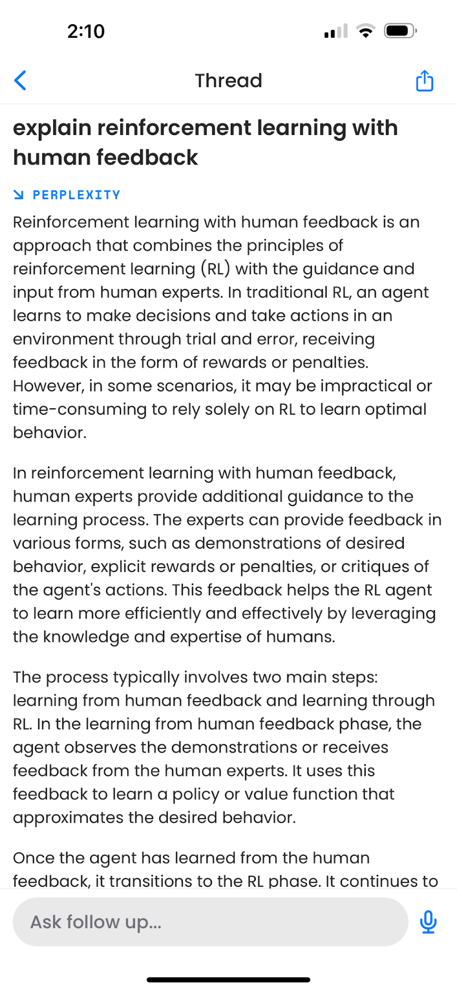
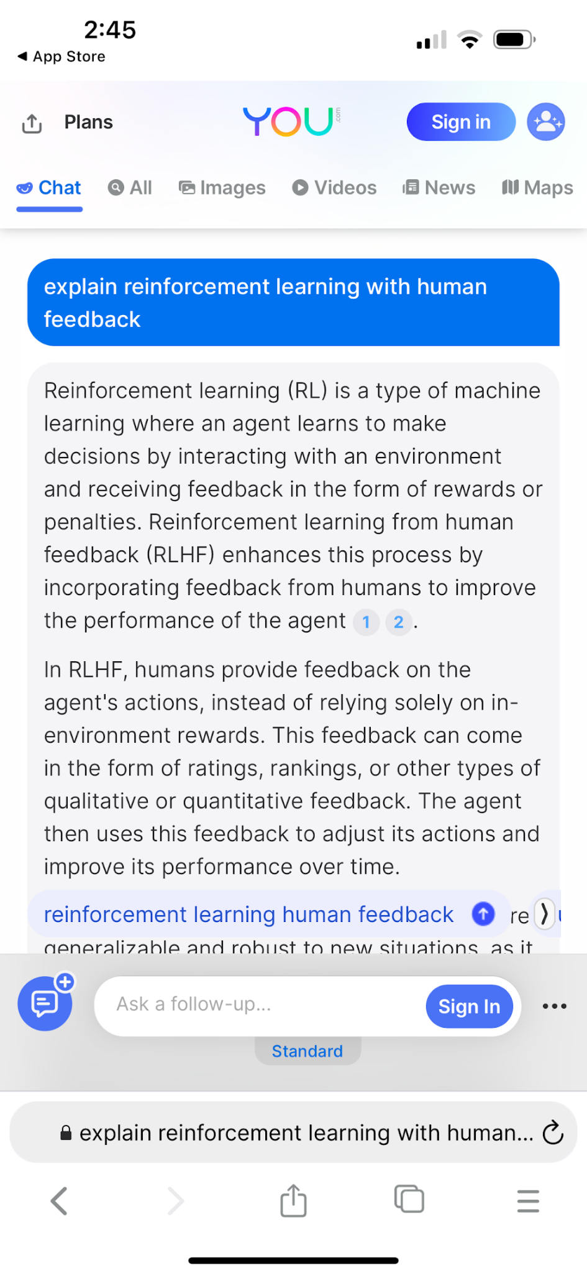
Cambrian explosion of Generative Question Answering systems
Magi
Bard
ChatGPT
Bing Chat
Perplexity
You
Notes:
What do I mean by “providing answers”? Over the last nine months, there has been a proliferation of commercial question answering systems powered by generative models. Here are screenshots of some of these systems. This collection is far from exhaustive, and new entrants arrive every other week – it is fair to say that we are seeing a “cambrian explosion” of such systems.

Slide 4
Value proposition of question answering systems
Question answering (QA) systems lower the cost (mental and time) of getting answers to questions
More direct than retrieval systems (which has advantages as well as risks)
Notes:
The core value proposition of question answering systems is to make it easy getting answers to questions – they lower the mental cost as well as the time required to get the answers you need. They can address information needs more directly than traditional retrieval systems, at the risk of users becoming overly trusting and reliant on such systems.

Slide 5
Outline of this talk
The Evolution of Retrieval Systems
Language Models for Question Answering
Closed-book vs Open-Book Question Answering Systems
Generative Models and the Web Ecosystem
Key Takeaway Points
Notes:
Here is the outline of my talk: first I will review the evolution of retrieval systems from the 1950s to the present. Next I will talk about how language models can be used for question answering. Then I will discuss two competing designs, closed-book QA systems and open-book QA systems. After that, I will touch on how this technology may change the dynamics of the web ecosystem and the search business. And finally, I will wrap things up and leave you with a few key takeaway points. Hopefully, it will also leave you convinced that generative question answering is not the end of classical information retrieval, but rather opens up a new frontier of exciting and important research problems.

Slide 6
The Evolution of
Retrieval Systems
Notes:
Before we talk about the present and the future, it is helpful to review the past and to understand why retrieval systems evolved the way they did.

Slide 7
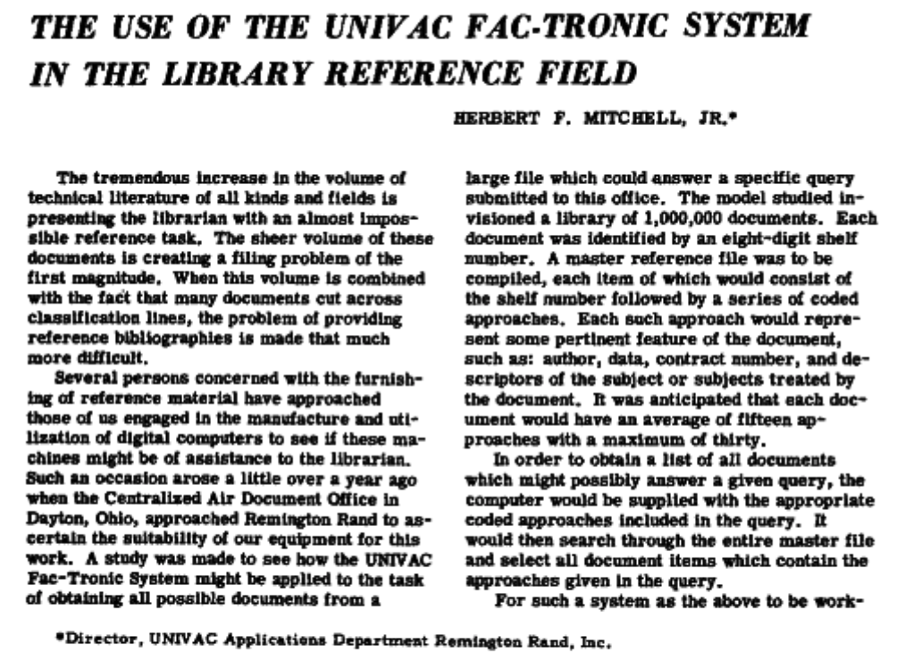
Information Retrieval is a mature field!
American Documentation 1953, https://doi.org/10.1002/asi.5090040105
Notes:
The British historian Alan John Percivale Taylor said that “war is the mother of invention”. In the case of information retrieval, that mother was peace. The end of World War II led to reams of technical documents to be declassified and to become accessible to a non-military audience. Researchers and engineers were eager to absorb the newly available literature, but librarians were overwhelmed by the task of surfacing these documents to interested parties. This led to early investigations into the use of computers for assist librarians. Here is a paper published in 1953 describing the “Fac-Tronic” system, one of the earliest computer-based retrieval systems. Fac-Tronic allowed the librarian to query by author, DoD contract number, subject headers and subject descriptors, and would return the shelf location of matching documents. Searching for matching documents was done using a brute-force approach – a linear scan over the list of available documents.

Slide 8
Classical Retrieval Systems
Retrieval systems have followed the same paradigm for the past 70 years:
Frame an information need as a query
Submit the query to the retrieval system
Get references to documents that may satisfy your information need
References may be rank-ordered by decreasing relevance
Results may contain relevant excerpts from each document (“snippets”)
Notes:
Fac-Tronic and its successor systems defined the paradigm that dominated information retrieval for the following 70 years. An individual with an information need frames this information need in the form of a query, submits the query to the retrieval system, and gets back a list of references to documents that are likely to satisfy the information need, ideally in relevance-ranked order and with short excerpts of relevant passages.

Slide 9

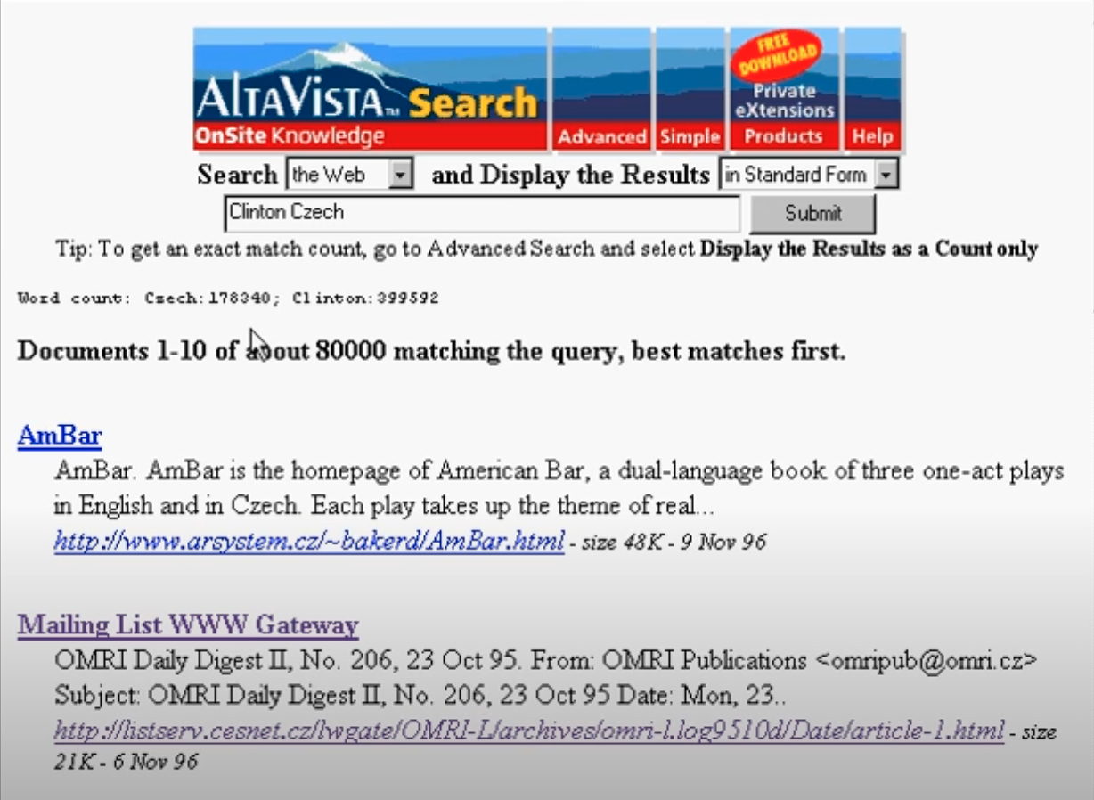
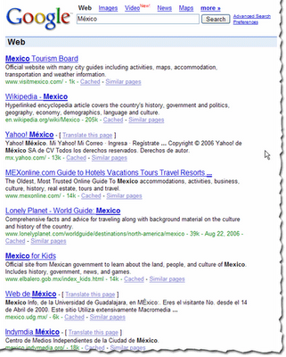
User experience of web search engines from 1996 to 2023
Altavista search results in 1996
https://www.youtube.com/watch?v=X5rjFLwXgew
Google search results in 2006
https://developers.google.com/search/blog/2006/08/how-search-results-may-differ-based-on
Google search results in 2023
Original screenshot
Notes:
Fast forward to the invention of the web and the rise of web search engines. Here are some screenshots showing the user experience of search engines over the past 27 years. While the experience is much more polished today than it was in 1996 (screenshot on the left), the basic paradigm remains unchanged – users submit a query describing their information need, and get back a list of links to potentially relevant web pages, along with a short “snippet” allowing them to guesstimate the actual relevance without visiting the site. Contemporary search engines also answer some categories of queries directly – about the weather or basic factoids – but the majority of queries produce “10 blue links”.

Slide 10
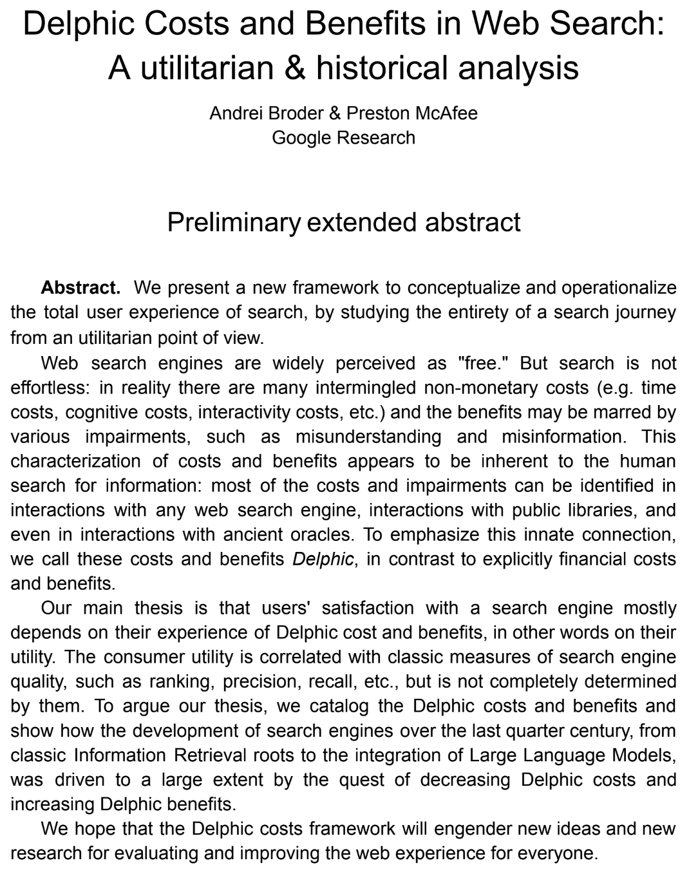
On the cognitive load of classic retrieval systems
Information seeking activities have non-monetary costs: time investment, cognitive load, interactivity costs. Call them “Delphic Costs”.
User satisfaction with search engines is correlated with successful outcomes (did the user need get satisfied?) as well as Delphic costs (how difficult was it to find the information?)
Much of IR research to date can be seen through lens of Delphic cost:
Synonym expansion lowers cognitive load of framing query
Ranking lowers time cost of scanning through results
Snippeting lowers time cost of highly- ranked irrelevant results (easier to skip)
arXiv paper forthcoming
Notes:
So what is wrong with “ten blue links”? As it turns out, there is a cost to using classic retrieval systems, both in terms of time and cognitive load. Users have to frame an information need as a query, and scan the list of potentially relevant results for the document, or maybe several documents, that answer their need. Andrei Broder and Preston McAfee refer to this as the “Delphic Cost” of information gathering – an arXiv paper on the concept is forthcoming. Much of IR research over the past 70 years has been about lowering Delphic Cost. Research in query expansion makes it easier to frame queries that produce responsive results, research in ranking makes it easier to locate the most relevant result, and research in snippet generation makes it easier to skip irrelevant results.

Slide 11
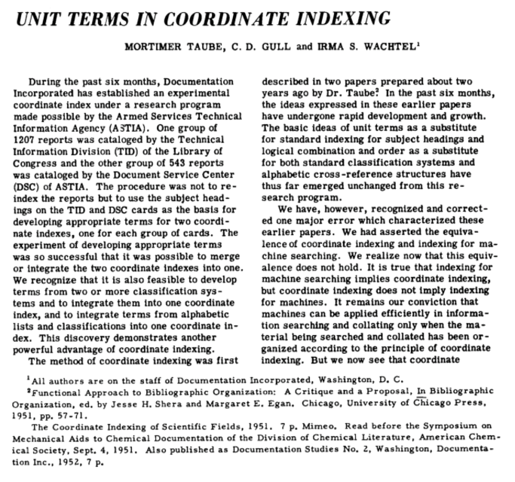
Unit terms as document representations
Key findings:
Documents relevant to an information need can be efficiently identified by the terms (words) they contain (in their subject heading, abstract, or body)
The alternative approach is to assign a hierarchical subject descriptor (e.g. using the Dewey Decimal System) to each document and query using that descriptor
American Documentation 1952, https://doi.org/10.1002/asi.5090030404
Notes:
There are two very simple reasons why retrieval systems evolved the way that they did: They are effective at guiding people to needed information, and we understand how to build them. And it is all due to two ingredients: terms as the representation primitive, and inverted indexes as the retrieval mechanism.
Recall the Fac-Tronic system from the early 1950s that I mentioned earlier. It allowed users to search the document collection by government contract numbers, authors, and subject headers and descriptors. Contract numbers and author names are useful for locating known content, but not for exploring unknown information territory. Subject headers are more useful, but they rely on somebody having extracted all the relevant headers.
Recognizing these shortcomings, Taube, Gull and Wachtel suggested in 1952 to index the individual words in a document – its title, subject descriptors, keywords, and eventually abstract (indexing the full text was still out of reach). They called this approach “Uniterm coordinate indexing” – in essence, representing documents as a bag of words.

Slide 12

How did we get here?
Key finding:
Uniterm-based systems perform at least as well as hierarchical document classification schemes
This finding was initially highly controversial but was validated over the next few decades
Proc. of the International Conference on Scientific Information (1959), https://doi.org/10.17226/10866
Notes:
In a 1959 landmark study, Cyril Cleverdon compared the Uniterm system against three other approaches, all based on hierarchical document classification. He found that Uniterm performed at least as well as the more traditional approaches. These findings were very controversial when published, but have been reproduced many times since. This paper provided the proof-point that using an index of term occurrences in a collection is an effective retrieval mechanism.

Slide 13
Structure of an inverted index
Inverted index with postings lists
Corpus of documents
be
…
…
…
327
331
…
…
…
321
322
323
324
325
is
…
…
…
…
…
333
…
…
…
to
be
or
not
to
326
327
328
329
330
not
…
…
329
…
…
…
…
be
that
is
the
or
…
…
…
328
…
…
…
…
331
332
333
334
335
that
…
…
332
…
…
…
336
337
338
339
340
the
…
…
…
…
…
334
…
…
…
to
…
…
…
…
326
330
…
…
…
[EOD]
…
…
…
…
340
…
…
Notes:
In the Uniterm world, we need a mechanism to map query terms to documents. This can be done efficiently via an inverted index. Each word in the vocabulary of the document collection maps to a “postings list”, a list of all positions in all documents where that word occurs. The inverted index supports complex queries: conjunctive queries, disjunctive queries, proximity queries, phrasal queries, and even exclusion or negation queries. Queries can be composed, affording a rich language for expressing information needs. As an extra benefit, the index makes it easy to compute lexical scoring functions such as tf-idf and BM25.
Because the inverted index is so well-suited to Uniterm-style retrieval systems, it was received much attention from researchers and engineers. There is a rich body of work on index compression, index updates, index stratification , and index sharding. Jeff Dean gave a delightful keynote at WSDM 2009 where he described how Google redesigned their index seven times over ten years, to cope with the explosive growth of their user base.

Slide 14
Using an inverted index shapes your view
Terms are uninterpreted tokens
Synonymy is handled through query expansion
AND, OR, NEAR can be done efficiently
Fairly easy to scale (via sharding)
Fairly easy to update (via tiering)
Perfect match to Salton’s term vector model
Term frequency easy to determine – tf.iDF, BM25 etc easy to implement
Difficult to find semantically (as opposed to lexically) similar documents
Notes:
Let me recap the key properties of this lexical approach to document retrieval. Terms are uninterpreted; the index does not capture semantic similarity between terms. For example, turtle and tortoise are completely separate words as far as the index is concerned, although in English they are synonyms. To cope with this limitation, retrieval systems base on inverted indices usually have a pre-retrieval stage that augments query terms with their synonyms plus some weights used for scoring.
Boolean and proximity operators can be implemented very efficiently, just by traversing the postings lists of all query terms in lock step. It is also reasonably easy to scale indices to very large corpora, by sharding them across many computers. Likewise, it is straightforward to update the index, by slicing the index into multiple tiers, creating a new tier for each batch of updates, and periodically merging multiple tiers.
The inverted index is a perfect match for Salton’s term vector model. The structure of the index makes it trivial to determine how many times a term occurs in a document, and it is easy to maintain side information on how many documents contain a given term. So, we can easily compute metrics such as tf.iDF or BM25 while traversing the postings lists.
On the other hand, the inverted index is not well-suited to find documents that are semantically (not merely lexically) similar to a query or to another document.

Slide 15
Architecture of “classical” web retrieval system
off-line / crawl-time
on-line / query-time
Corpus Builder
Corpus
Corpus Server
Content
Crawler
2
Search Front End
Users
Index Builder
Inverted Index
Index
Server
1
“Classical” lexical retrieval system
Notes:
Here is the architecture of a “classical” web search engine, at a very high level. The system is has two parts, an offline component responsible for acquiring and pre-processing web content, and an online component responsible for receiving queries and returning result pages. The two halves are joined by two repositories – the corpus of crawled web pages, and the index of all terms in these pages. Web content is obtained by a crawler (using a complex scheduling policy that attempts to maximize index utility) and incorporated into both the corpus and the index. User queries are received by a front end, which first obtains references to relevant documents from the index and then obtains the corresponding documents from the corpus and extracts a snippet to accompany each result.

Slide 16
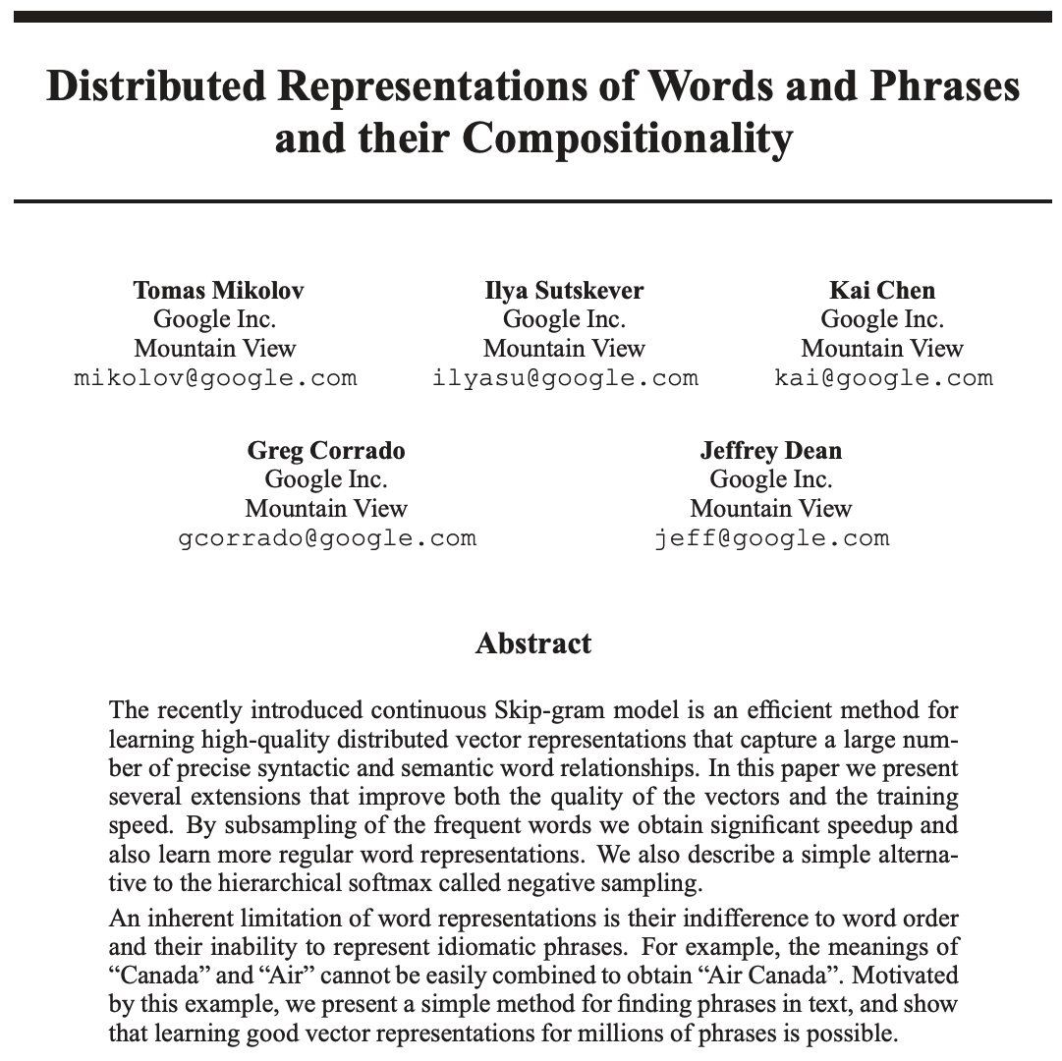
The advent of word embeddings
Key concepts:
Words represented by vectors of real numbers – an “embedding”
Word embeddings are informed by neighboring words (“context”)
Semantically similar words are “close” in word embedding space
Implementations: word2vec (Google), GloVe (Stanford), fastText (Meta), …
NeurIPS 2013, https://papers.nips.cc/paper_files/paper/2013/file/9aa42b31882ec039965f3c4923ce901b-Paper.pdf
Notes:
Back in 1957, John Rupert Firth, a linguist known as the father of “distributional semantics”, coined the pithy phrase “You shall know a word by the company it keeps”. Words are not distributed independently from each other across documents in a corpus – semantically related terms are a more likely to co-occur than unrelated terms. This property is of course well-known to the IR community – techniques like Latent Semantic Analysis rely on it. On the other hand, the vector space model proposed by Salton assumes that terms are statistically independent – in my mind, a fine example of how the tools we have (in this case, the inverted index) narrows our view of problem space.
Alas, the early 2010s saw two breakthroughs that shook things up. One was the invention of word and document embeddings, which capture semantic relatedness between words, sentences, paragraphs or documents, and the other was the maturation of vector databases – systems that store vectors of numbers and, given a vector, return its k nearest neighbors in the store in an efficient manner.
Here is a 2013 paper by colleagues at Google that introduced the concept of word embeddings. Each word is represented by a fixed-size vector of real numbers. The learner is presented with a word and its “context” – k neighboring words to its left and to its right. The training objective is to learn a word representation that is good at predicting the context words. This representation captures the essence of Firth’s idea – semantically related terms are have embeddings that are close in embedding space. There are many open-source implementations of word embedding trainers – I listed a few.

Slide 17
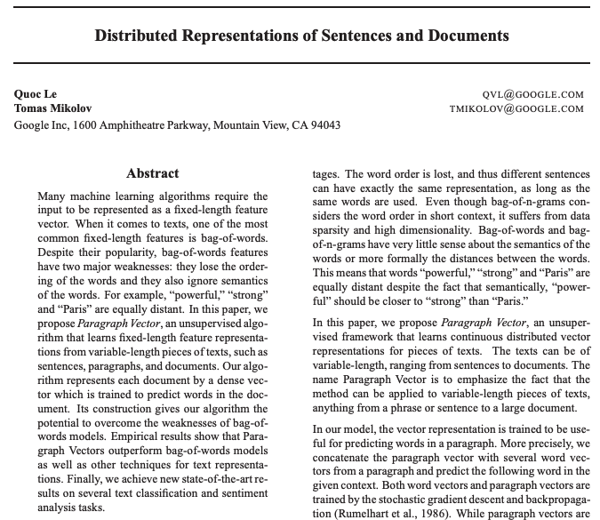
From word embeddings to document embeddings
Key ideas:
Generalizes word embeddings to sentence / paragraph / document embeddings
Variable-length passage represented by fixed-length vector
Similar documents “close” in vector space (under e.g. cosine similarity)
ICLR 2014, http://proceedings.mlr.press/v32/le14.pdf
Notes:
A follow-on 2014 paper, again by colleagues at Google, generalized word embeddings to variable-length sequences of words – sentences, paragraphs or entire documents. The representation of such a variable-length sequence of words is still a fixed-length vector of real numbers, and similar passages are close together in embedding space. This provides us with an alternative document representation to Salton’s term vector model – one that captures “soft” semantic similarity as opposed to “hard” lexical overlap between document-document or query-document pairs.

Slide 18
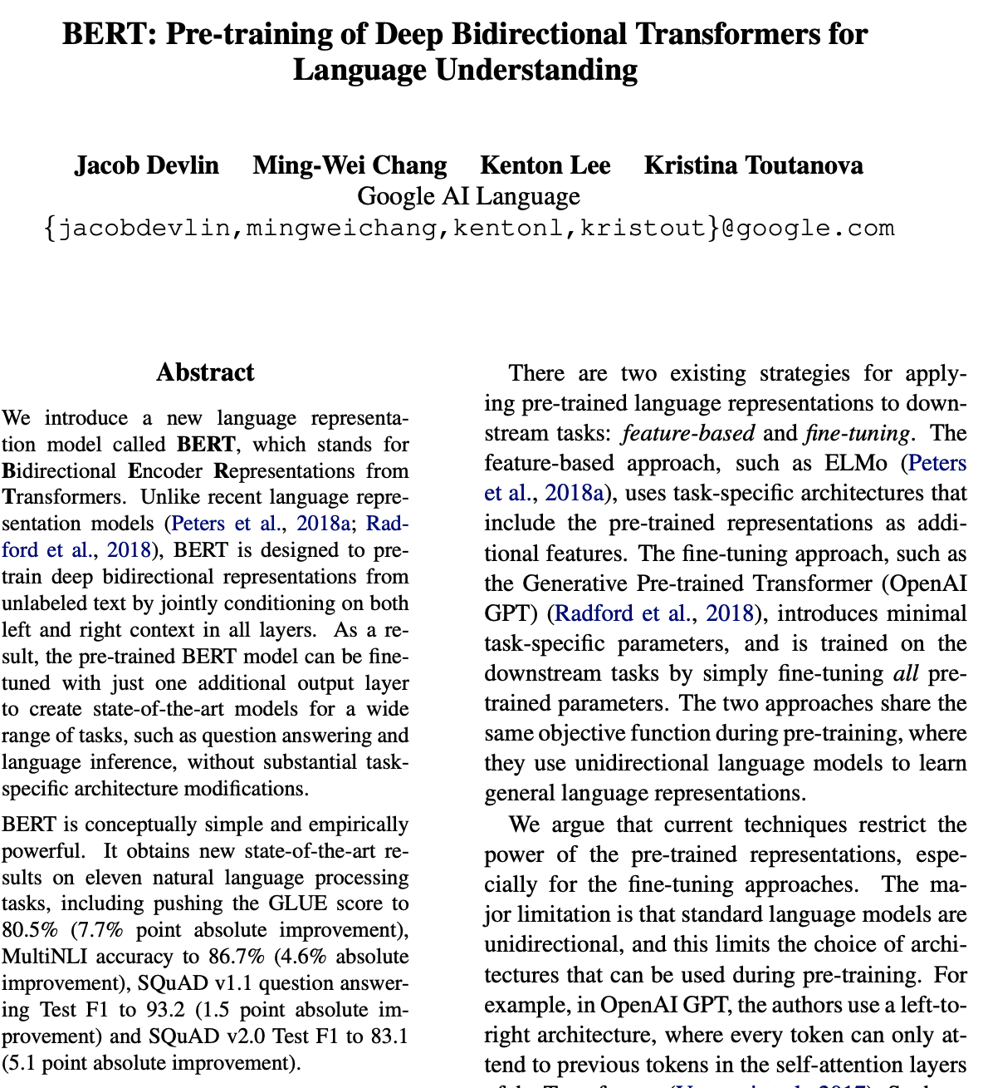
Pre-trained language models
Key advances:
Bi-directional sequence modeling.
Contextual – homonyms have different representations
More scalable than previous approaches due to using transformers as opposed to LSTMs used by ELMo
Two training objectives: predicting masked-out-words (MLM or “cloze”), and predicting next word(s)
Established new SotA for many tasks, including ranking
NAACL-HLT 2019, https://aclanthology.org/N19-1423
Notes:
The parameters of the neural network used for mapping paragraphs to embeddings capture the essence of the languages the training examples were written in – they form a “language model”. The larger the model is, the more accurately it will capture the vocabulary, morphology, and grammar of the languages. Training large models is computationally expensive, so there has been a trend towards pre-trained language models – models that are trained using training objectives for a few key tasks, and that can be subsequently adapted to other tasks via fine-tuning on a few more task-specific training example and using task-specific training objectives.
A key exponent of that trend was BERT, published by colleagues at Google in 2019. BERT is based on sequence modeling, and it is bi-directional, meaning that it considers neighbors both to the left and to the right of the target word. This makes representations contextual – homonyms will have different representations for their different meanings.
BERT uses transformers, which are computationally much cheaper than LSTMs (as used by the earlier ELMo model from AllenAI), and therefore allows for much larger models.
BERT was pre-trained using two objectives – predicting words that were randomly masked out in each training example ( a task known alternatively as “masked language model” or “cloze”), and predicting the next word in a sequence. BERT has been used widely and established state-of-the-art performance on a wide range of other tasks, including IR tasks such as ranking.
The state-of-the-art in pretrained language models continues to evolve rapidly; I will not attempt to give you a blow-by-blow account of work post BERT, but will throw in a mention of the 2022 paper by colleagues at Google that describes “PaLM”, the Pathways Language Model. At a high-level, the thrust of research is on creating pre-trained models that are multi-lingual, multi-modal, multi-task, and generative.

Slide 19
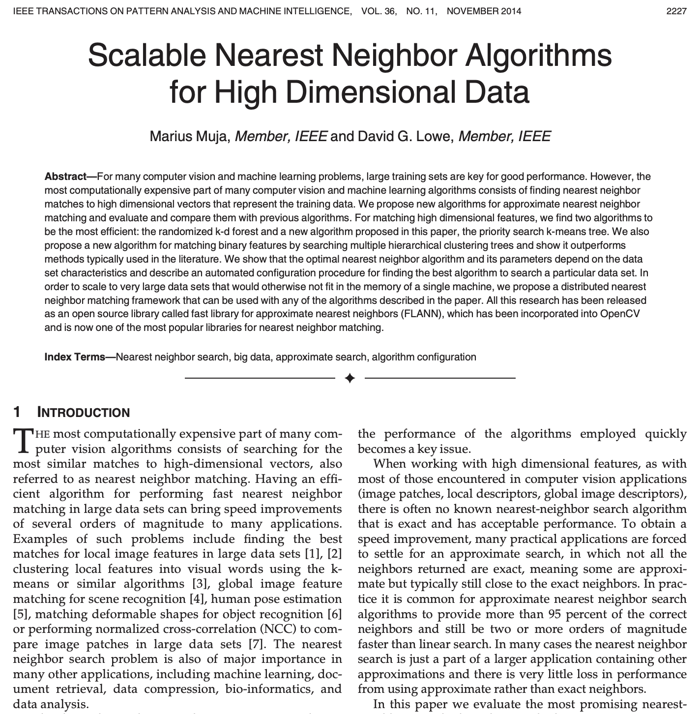
Term vector databases
Main functionality: Given a vector, return k closest vectors in the database
Techniques: Hashing, graph-based, …
Metrics: Euclidean distance, cosine similarity, …
Many available implementations: FLANN (UBC), ScaNN (Google), FAISS (Facebook), Pinecone, Weaviate, …
IEEE TPAMI 2014, https://doi.org/10.1109/TPAMI.2014.2321376
Notes:
Vector-based document representations are only useful if we are able to find similar vectors efficiently – in other words, if we have fast nearest-neighbor search for high-dimensional vectors of real numbers. Luckily enough, there has been a fair amount of work on such systems over the past decade or so, and there are a number of available systems. The above paper is one of the earliest describing such a system, and it comes with an open-source implementation. Today’s industry-grade systems are distributed, fault-tolerant and scale to billions of vectors.

Slide 20
Architecture of semantic retrieval system
off-line / crawl-time
on-line / query-time
Corpus Builder
Corpus
Corpus Server
2
Content
Crawler
Search Front End
Users
Document
Embedder
Vector DB
Embedding Server
1
“Deep” semantic retrieval system
Notes:
Armed with documents embeddings and vector databases, we can revise the architecture of the classical retrieval system to leverage semantic rather than lexical features. The inverted index is replaced by a vector database. In such a system, there is no (or at latest less) need to expand query terms with synonyms.

Slide 21
Contrasting lexical and semantic representations
Lexical representation (term vector):
High-dimensional (billions)
Sparse
Term vector model
Words are uninterpreted tokens
Computationally cheaper
Easy to scale inverted index
No explicit language model (caveat: pre & post retrieval)
Semantic representation (embedding):
Low dimensional (hundreds)
Dense
Distributional semantics
Words have meaning
Computationally more expensive
Harder to scale nn-index
Updating language model very expensive
Notes:
To recap, here are some key differences between lexical and semantic representations of documents: term vectors have a huge dimensionality – one dimension for for each word in the vocabulary – and are extremely sparse, while document embeddings have a much lower dimensionality and are dense. In Salton’s term vector model, words are uninterpreted tokens, in Firth’s distributional semantics, words have meaning. Dealing with lexical tokens is computationally cheaper than computing word and document embeddings, and it is easier to scale inverted indices than to scale vector databases. Finally, updating the language model used by a semantic retrieval system is computationally very expensive, while the term vector model does not have an explicit language model, although it does capture word frequency distributions. However, it’s worth pointing out that in modern search engines, pre-retrieval steps such as query expansion and post-retrieval steps such as ranking typically do rely on sophisticated language models.

Slide 22
Architecture of hybrid lexical/semantic retrieval system
off-line / crawl-time
on-line / query-time
Corpus Builder
Corpus
Corpus Server
2
Content
Crawler
Document
Embedder
Vector DB
Embedding Server
Search Front End
Users
1
Index Builder
Inverted Index
Index
Server
1
Hybrid lexical/semantic retrieval system
Notes:
There are a few arguments for combining lexical and semantic retrieval. Commercially available vector databases are not yet as scalable as inverted indices, although the gap is closing rapidly. Inverted indices have higher locality of reference, so the index does not need to reside entirely in RAM. And inverted indices are very suitable for “precision queries” where recall is important, such as looking up a very unique and uncommon part number. So, there is room for hybrid retrieval systems that store all documents in an inverted index and the most valuable subset of the corpus in a vector database. At query time, results are retrieved from both subsystems and fused together.

Slide 23
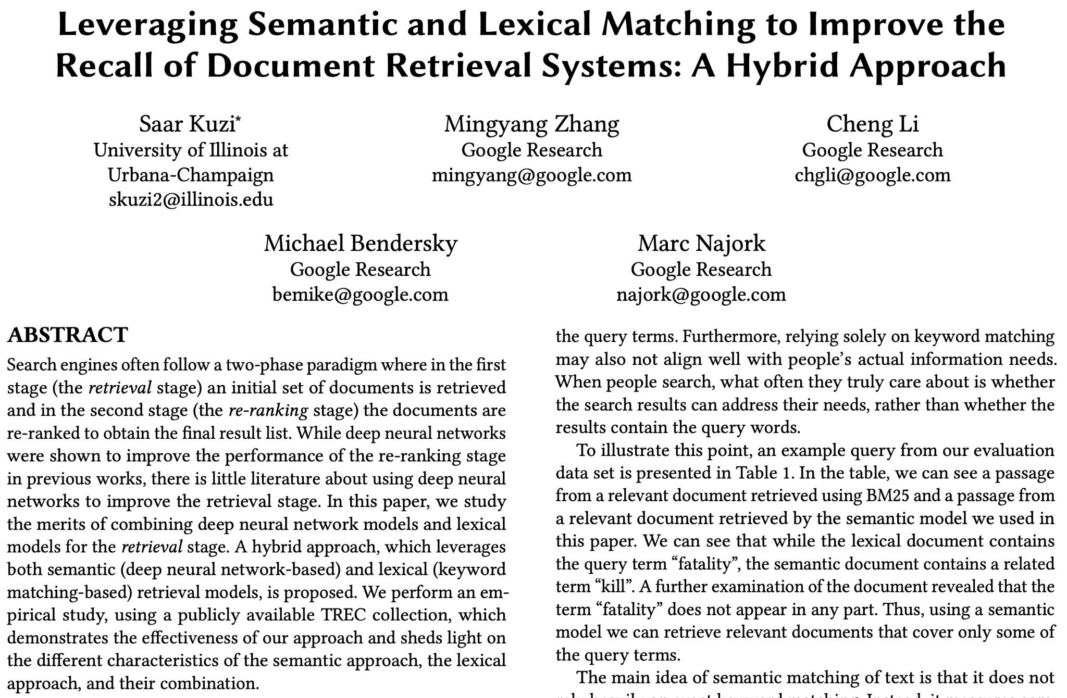
Semantic and lexical matching complement each other
Lexical: BM25, Anserini (Lucene)
Semantic: BERT, ScaNN
Fusion: RM3
Data sets: TREC newswire
Hybrid approach has superior recall & higher precision
arXiv 2020, https://arxiv.org/abs/2010.01195
Notes:
Here is quick plug for a another paper coming out of Google, one that I was a part of. In this work, we evaluated such a hybrid system. Since the work was intended to be be reproducible by the academic community, we used open-source components and open benchmarks. For the lexical portion, we used Lucene as the indexer and BM25 as the ranker, for the semantic portion, we used ScaNN as the vector database and a BERT-based ranking model. The fused the results of the two subsystems using RM3. Benchmarking on the TREC newswire dataset, we found that recall of the combined system was substantially higher than either subsystem, and precision was improved as well.

Slide 24
Language Models for Question Answering
Notes:
Up to this point, we have reviewed how classical IR systems have evolved, and how progress in language modeling has brought about more sophisticated retrieval systems. Next, we will discuss how that same progress enables a new information-seeking experience where questions are answered directly.

Slide 25
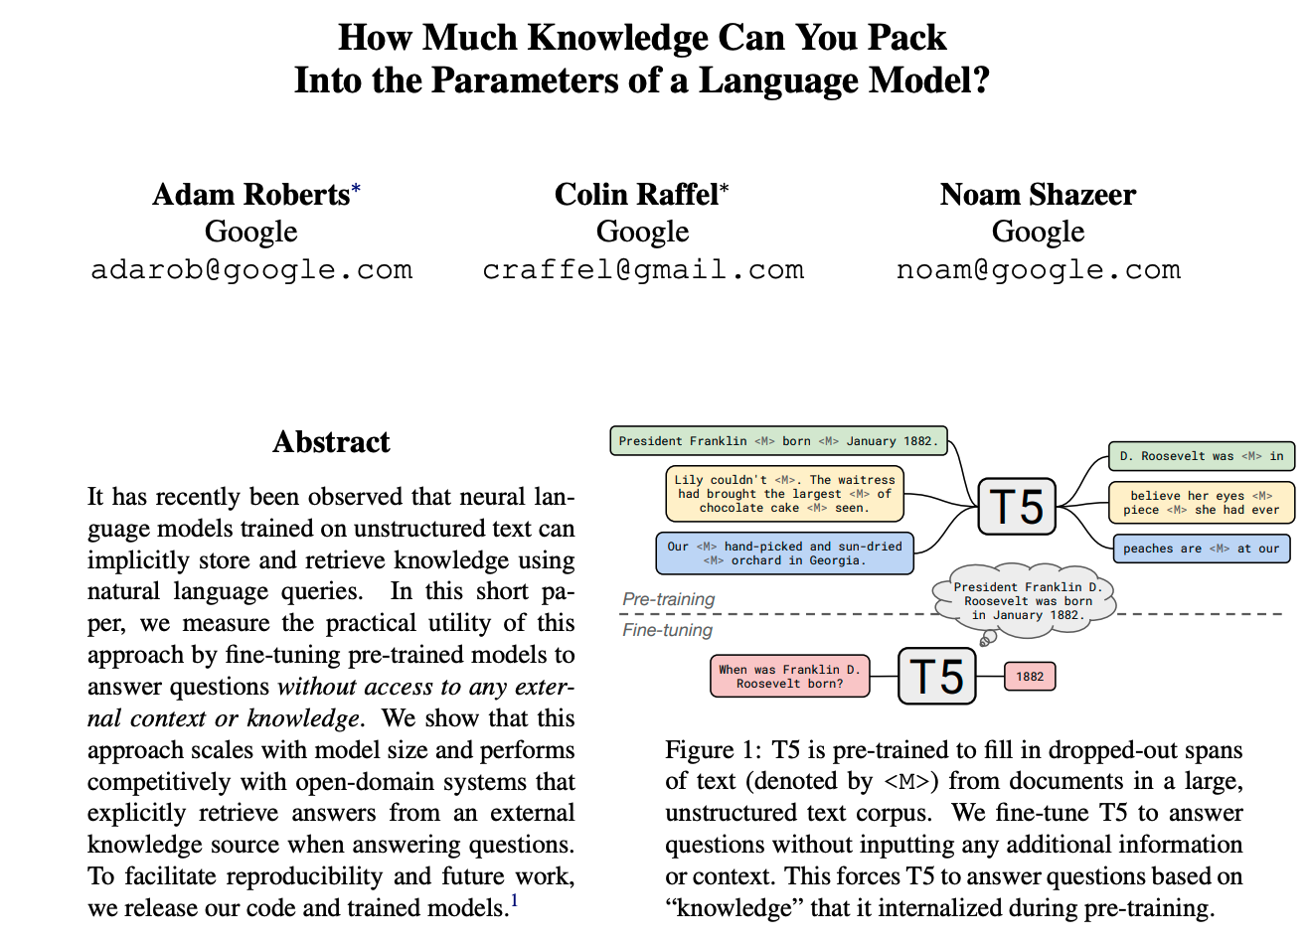
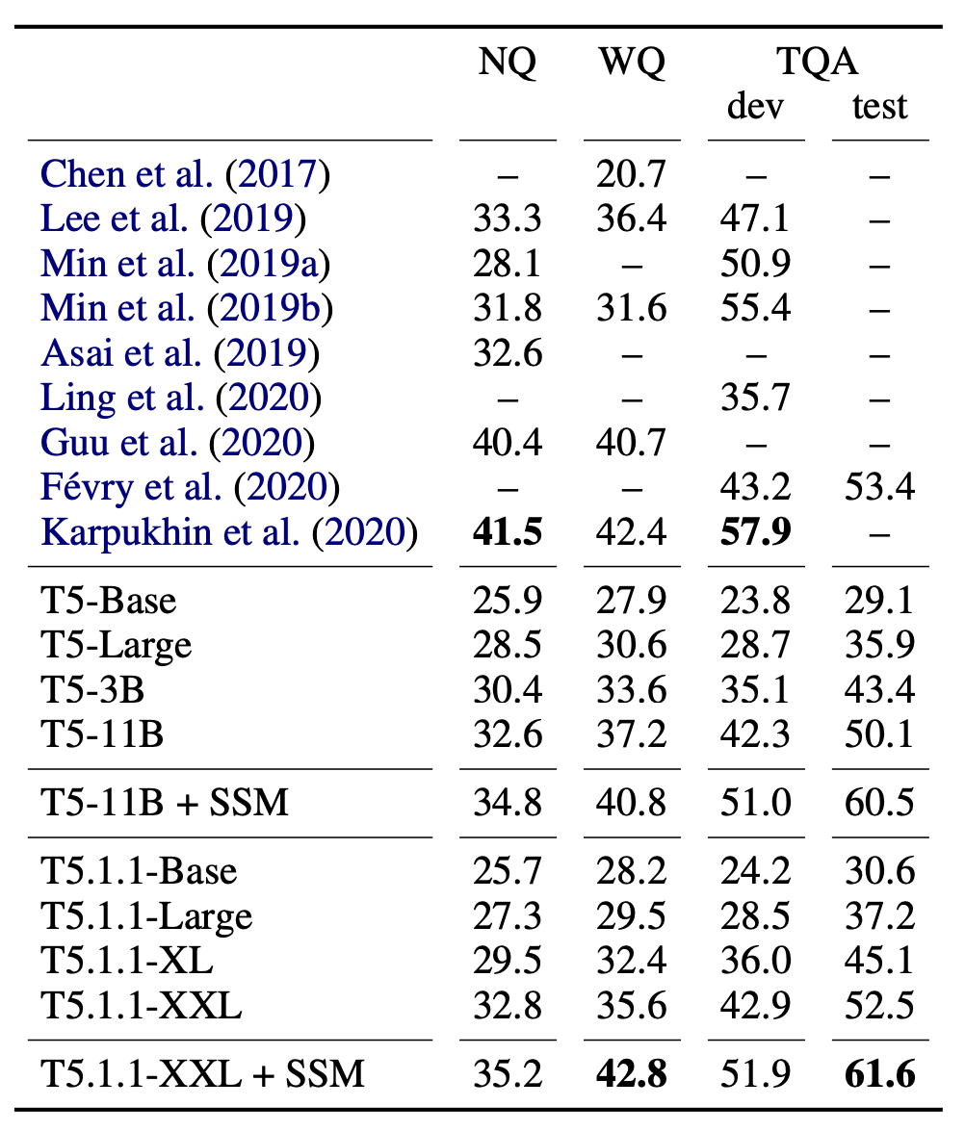
Language models as knowledge repositories
EMNLP 2020, http://dx.doi.org/10.18653/v1/2020.emnlp-main.437
Notes:
NLP researchers soon observed that large language models not only absorbed the vocabulary, morphology and grammar of the languages the training documents were written in, but that they also memorized basic factoids found in these training examples. Colleagues at Google set out to quantify just how much factoid information is contained in the parameters of such a model. Specifically, they studied T5, a pre-trained model by Google that succeeded BERT and preceded PALM. They compared several T5 models of various sizes (fine-tuned for question-answering tasks) against nine contemporary QA; in other words, they pitted closed-book generative systems against open-book extractive systems. Questions came from three QA datasets: Natural Questions, WebQuestions, and TriviaQA. Evaluation was done using a combination of algorithmic checking and human assessment. The results were encouraging – the largest models T5 performed not quite as well as the state-of-the-art extractive QA system, but quite competitively with many.
Note to self: SSM stands for Salient Span Masking; training on such a task improves performance on open-domain QA tasks.

Slide 26
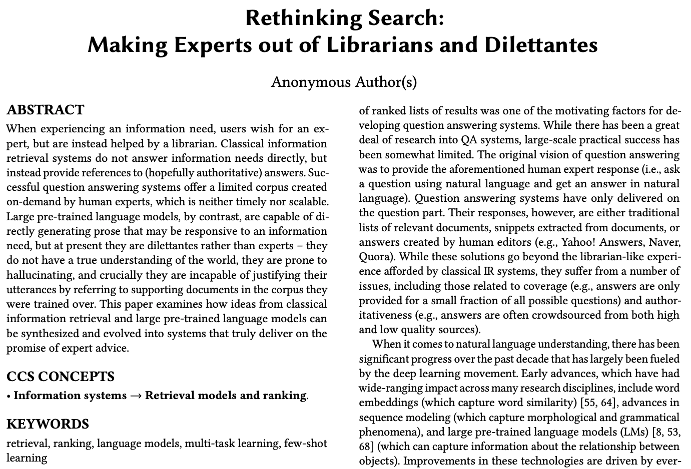
Attempt at SIGIR 2021 position paper
Key message: Generative models are able to create direct answers to questions, drawing either on knowledge in the LM or on external tools.
This is an evolution of (then) current direct answers that were factoid-focused and either purely extractive or database-driven.
Notes:
Inspired by the observations that language models capture common-world knowledge, we wrote a vision paper which suggested that language models could be used to answer questions in a generative fashion, presenting an alternative to the traditional approach that surface a list of references. We suggested that such a system would be preferable to traditional systems on a wide range of information-seeking tasks, because it lowers the “Delphic cost” to the searcher (the term Delphic cost had not been coined yet, but we captured its spirit).

Slide 27
Key desiderata laid out in “Rethinking Search”
Reliability: rely on authoritative sources during generation; remain faithful to the source material; avoid hallucinations
Transparency: Provide the provenance of information (via citation); aim to refer to primary sources
Unbiasedness: Avoid surfacing societal biases. The hardest problem, since biases are omnipresent – “there are no facts, just interpretations”
Diversity: For questions about controversial topics, aim to cover all points of view in a fair manner, without surfacing polarizing content
Accessibility: Answer in terms that are understandable to the user; surface any content in the language of the user. Requires knowledge of the user.
Notes:
We identified a number of properties that such a question answering system should have:
First of all, it should be reliable – that is, it should draw on authoritative sources when generating an answer, it should not hallucinate – that is, it should not make up answers that are not supported by evidence in source documents; and it should remain faithful to the sources.
Second, it should be transparent – that is, it should attribute each answer or each statement within the answer to a source document – much in the same way that Wikipedia does.
Third, it should be unbiased – that is, it should avoid surfacing societal biases that may be present in the underlying corpus. This is clearly the hardest objective, since biases are omnipresent – to quote Nietzsche, “there are no facts, just interpretations”. With that being said, the system should certainly provide a fair juxtaposition of all points of view for controversial topics, without surfacing polarizing or fringe opinions.
Any finally, the system should be accessible, meaning that it should phrase answers in a comprehensible way, whether that means using the language of the user or considering their background knowledge. This is another aspirational goal, and naturally it requires knowledge of the user.

Slide 28
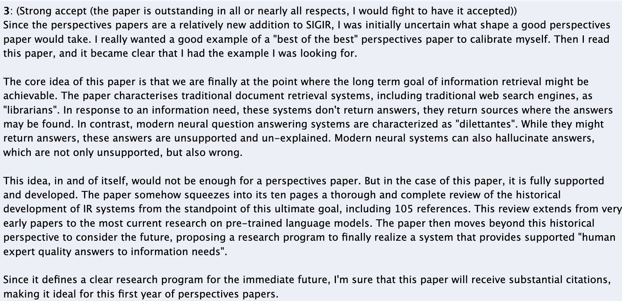
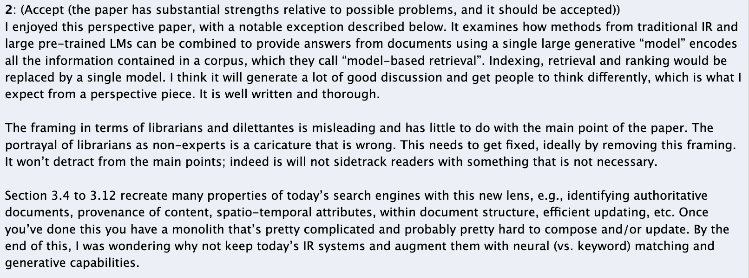
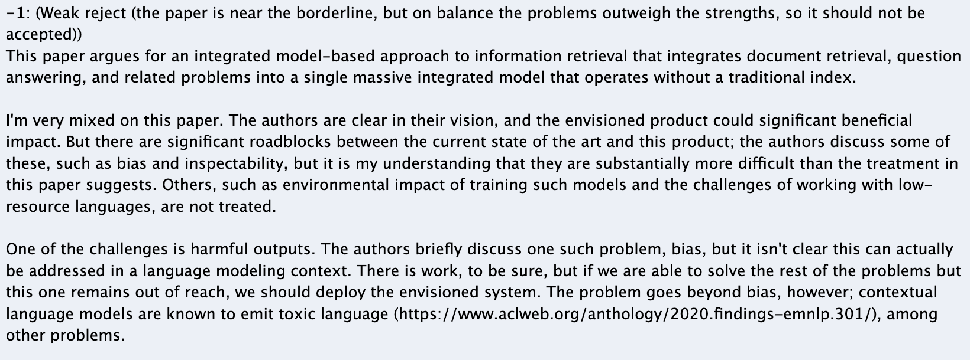
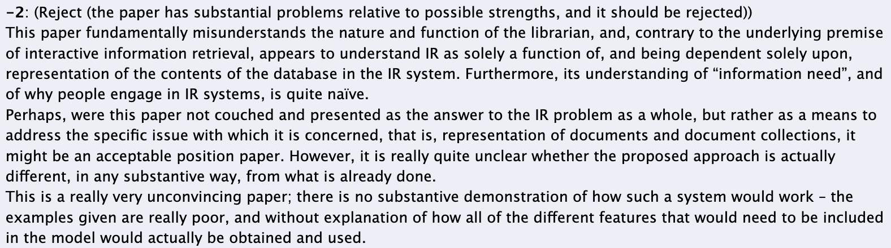
Reviewers were polarized
Google DeepMind
Notes:
We submitted this paper to the SIGIR 2021 Perspectives track. Let’s just say that the reviewers were polarized – “strong accept”, “accept”, “weak reject”, “reject”. The most positive reviewer thought this was a canonical example of a “best of the best” paper, while the most negative reviewer thought that our “understanding of information need … is quite naive”.

Slide 29
Summary of criticisms
Two reviewers thought that we denigrated librarians (not our intention)
Two reviewers raised concerns around bias, safety, toxicity, harm
Barrier to participation by academic researchers (LLMs are $$$)
Feasibility of vision
Novelty
Framing
Notes:
The reviewers identified several (perceived or real) shortcomings of the paper. Two reviewers chafed at our portrayal of librarians as non-experts. In retrospect, this is not surprising given how rooted information retrieval is in the library science community. It was certainly not our intent to denigrate librarians, we wanted to contrast the mode of interaction one has with a librarian with that one has with a domain expert. The librarian will help you find the primary sources that meet your information need, the expert will directly answer you need. Working with an expert lowers your cognitive load, at the price of you having to trust the competence of the expert.
Two reviewers raised concerns around the model regurgitating biased training examples, spouting toxic language, and the related risks of unsafe or outright harmful interactions. This is indeed a thorny problem and a focus of intense research.
One reviewer raised concerns about large language models creating new barriers to entry for all but the most well-funded corporations. This concern may be overstated. Researchers can use publicly-available language models as “black-box” building blocks, and the Alpaca work coming out of Stanford has shown that it is possible to adapt such models for very little money to a new task.
The most scathing review questioned the framing of the problem, the novelty of the idea, and the feasibility of the vision. The progress over the last two years has given us more confidence in the feasibility – as they say, “the proof is in the pudding”.

Slide 30
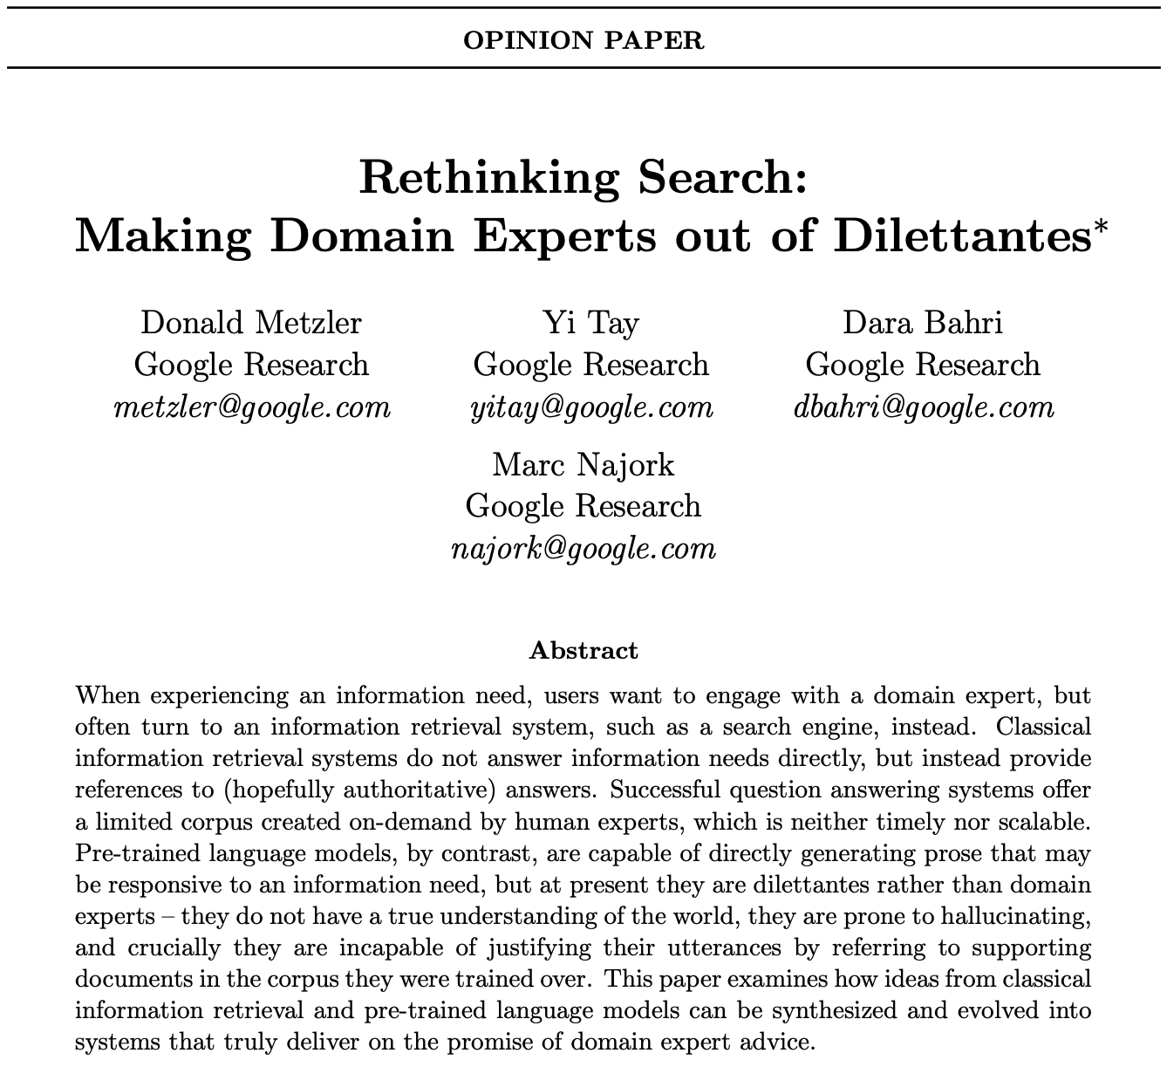
Getting the vision out as SIGIR Forum opinion paper
SIGIR Forum 2021, https://doi.org/10.1145/3476415.3476428
Notes:
We incorporated all constructive feedback; in particular, we removed all references to librarians, and we published the paper first on arXiv and then as a SIGIR Forum paper. The paper did get some coverage both by traditional news media and by the Twitterati.

Slide 31
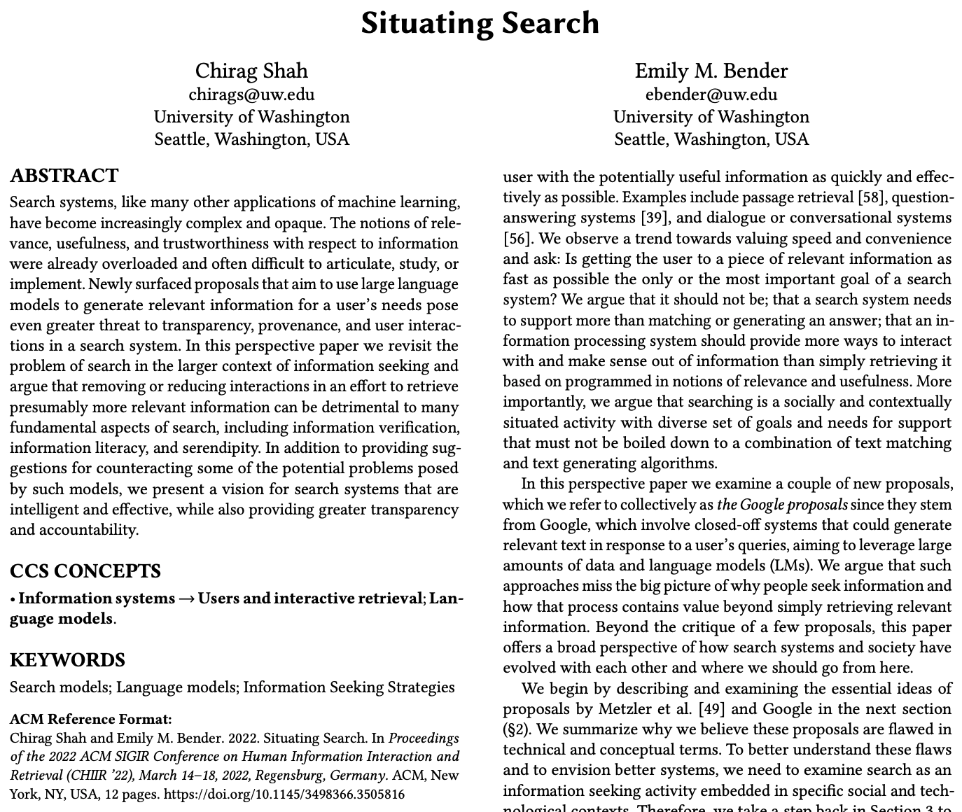
Critique in CHIIR 2022 perspectives paper by Shaw & Bender
CHIIR 2022 perspectives paper by Shaw and Bender, critiquing many of the ideas in “Rethinking Search” and the larger area of LM-based question answering.
Key assertion: users do not want LM-based QA systems; they advocate for “information seeking strategies”, directing them to authoritative primary sources.
CHIIR 2022, https://doi.org/10.1145/3498366.3505816
Notes:
The following year, Chirag Shaw and Emily Bender published a critique of “Rethinking Search” as a perspectives paper at CHIIR 2022. The core thesis of the paper is that users do not actually want generative question answering systems, they value the process of posing queries, deciding which results are trustworthy and relevant, and refining their queries as needed. In their opinion, generative question answering hurts information verification, information literacy, and serendipity.

Slide 32
Key points raised by “Situating Search”
Perceived technical flaws in the “Rethinking Search” vision:
LMs are no able to reason over structured information
LMs are prone to hallucinations
LMs understand form but not meaning, and thus cannot be trusted
Notes:
Shaw and Bender raised doubts that the vision of Rethinking Search was feasible from a technical point of view, and desirable from a societal point of view. On the technical front, they doubted that generative question answering systems could reason over structured information and could produce well-grounded and factual answers. Many of these issues are issues for generative models but non-issues for the larger question answering systems that leverage these models to generate answers, but ground the answers using evidence provided by explicit memory external to the model – retrieval systems, knowledge bases, nad reasoning engines. They also doubted that there is demand for such system, and I believe the last year has shown that there is.

Slide 33
Design Alternatives: Closed-book vs Open-Book Question Answering Systems
Notes:
Next, I will discuss two families of generative question answering systems: closed-book systems, where all knowledge is captured by the language model, and open-book systems, where the language model can draw on external memory, such as a retrieval system.

Slide 34
Alternative A: Closed-book generative question answering
Language model is the only source of knowledge leveraged during generation
Purist approach may allow for joint optimization of all system components
Multiple thorny issues:
Grounding (risk of hallucinations)
Transparency (attribution to sources)
Scalability (capturing all open knowledge)
Evolvability (knowledge grows & changes)
The Differentiable Search Index (DSI) is a stab at closed-book question answering
Support for attribution (capturing document ids in the LM), progress on evolvability and scalability
Work to date has not considered actual generation (and thus not worried about grounding)
Notes:
In the closed-book approach, all the world’s knowledge is captured by the language model, and the model does not draw on external memory prior to, during or after generation. It is an extreme point in the design space. Taking such a purist view has a few advantages, most notably that the model is all there is, making it possible to optimize the system end-to-end. However, there are multiple thorny issues: how do we makes sure that the generated answer is grounded? How do we attribute it to verifiable sources? How do we scale the model so that is truly can capture all the knowledge in the world, or at least on the web? And how do we update the model to keep up with the continuous change of the underlying corpus?
Colleagues at Google have taken a stab at some of these thorny problems. The Differentiable Search Index (or DSI for short) is a language model that is trained to map questions to documents containing answers, i.e. offering functionally similar to a traditional retrieval system, and there is some progress on evolvability and scalability. I should declare upfront that the team has not yet explored using DSI for actual generation, and therefore has not tackled grounding either. In other words, this work is still in its very early days.

Slide 35
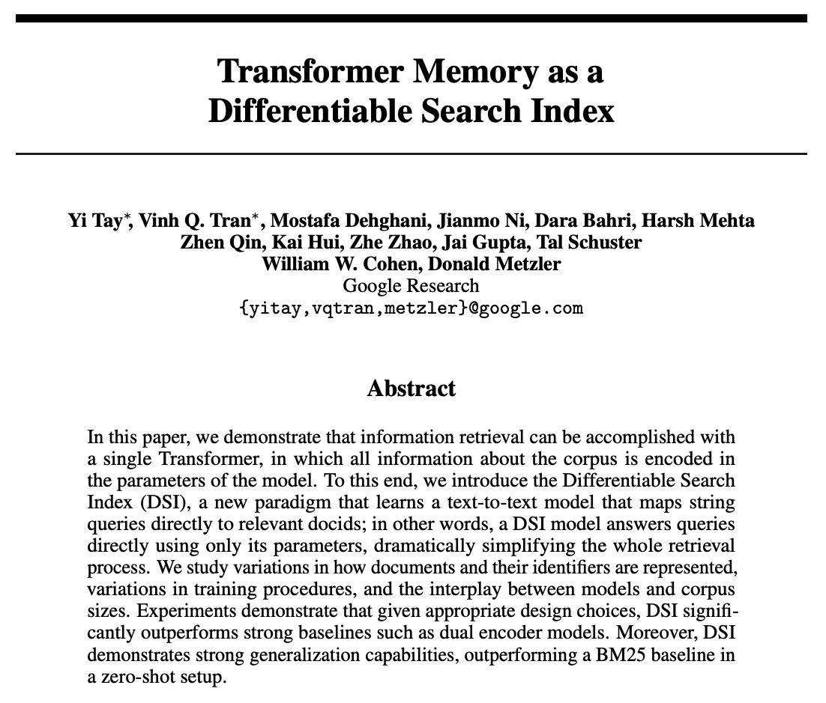
The Differentiable Search Index
DSI captures the identity of all corpus documents in a language model
Training: Given document tokens d_{j} predict docid j (a seq2seq task)
Fine-tuning: Given query q, predict docid j (also modeled as seq2seq task)
Inference: Given query q, predict docid j
Three schemes for representing docids:
Unstructured atomic identifier (e.g. numbers)
Naive string identifier (e.g. Wikipedia page titles)
Semantic string identifier (e.g. topic hierarchy)
NeurIPS 2022, https://openreview.net/forum?id=Vu-B0clPfq
Notes:
As I just said, the Differentiable Search Index is a language model trained for document retrieval. Given a query, the task is to return the document identifiers of documents that are relevant to that query. In order to achieve this task, we split the training task into two phases.
During the first phase, the model is presented with the tokens of each document in the corpus and asked to predict the identifier of the given document. We treat this as a sequence-to-sequence task, with both documents and identifiers a sequence of tokens. This phase is analogous to the “indexing” subsystem of semantic retrieval systems – the model memorizes a mapping from documents to document identifiers.
During the second phase, the model is given a set of queries and asked to predict the docid of relevant documents – again modeled as a sequence-to-sequence task. During that phase, the model learns the actual retrieval task – mapping queries to relevant documents.
Finally, the inference step maps a query to the n documents most likely to be responsive to the query.
Tay et al experimented with several schemes for representing document identifiers: unstructured atomic identifiers – for example, unique numbers; naive string identifiers – for example, the title of a Wikipedia entry; and semantic string identifiers that place the document within a hierarchy of topics – think Dewey.

Slide 36
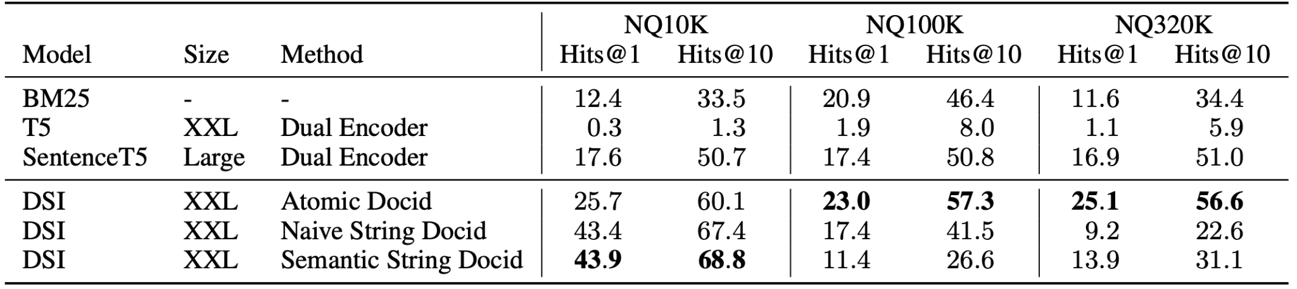
Evaluating DSI as a retrieval mechanism
Dataset: Natural Questions [Kwiatkowski et al 2019] – 315K question-docid pairs, underlying corpus is subset of Wikipedia induced by docids.
Task: for each question, find the document containing the answer
Baselines: Lexical retrieval model (BM25), semantic retrieval models (T5 & ScaNN)
DSI benchmarked for three different docid encoding schemes
Notes:
Heads-up for Don: The NeurIPS paper mentions table 4 in the appendix, but does not have an appendix. The arXiv version has it. Possible to update OpenReview?
The team compared DSI against three traditional retrieval systems – one lexical and two semantic. The lexical system used a traditional inverted index for retrieval and BM25 for ranking. The semantic systems used the standard dual-encoder approach – mapping both queries and documents into the same embedding space, and using ScaNN to receive the n documents most similar to the query. One system used T5 to produce the embeddings, the other SentenceT5. DSI was initialized from pretrained T5 checkpoints and trained and fine-tuned as previously described.
The queries are taken from Natural Questions, a collection of 315,000 question-answer pairs, or in this context, questions paired with the docids of their answers, and the corpus is the portion of Wikipedia induced by the queries. The authors explored query sets and corpora of different sizes, ranking from 10,000 queries all the way up to 315,000 queries.
The task was to map each question in the validation split to 1 or 10 docids. The evaluation measure is Hits@n – for what fraction of queries did the system retrieve the correct docid within the top n results? The table here shows the results in a zero-shot setting, where DSI was trained to map documents to docid but not trained to map queries to docids. It still does amazingly well. In the non-zero-shot setting, semantic string docids perform better than in the zero-shot setting – I refer you to the paper for details.

Slide 37
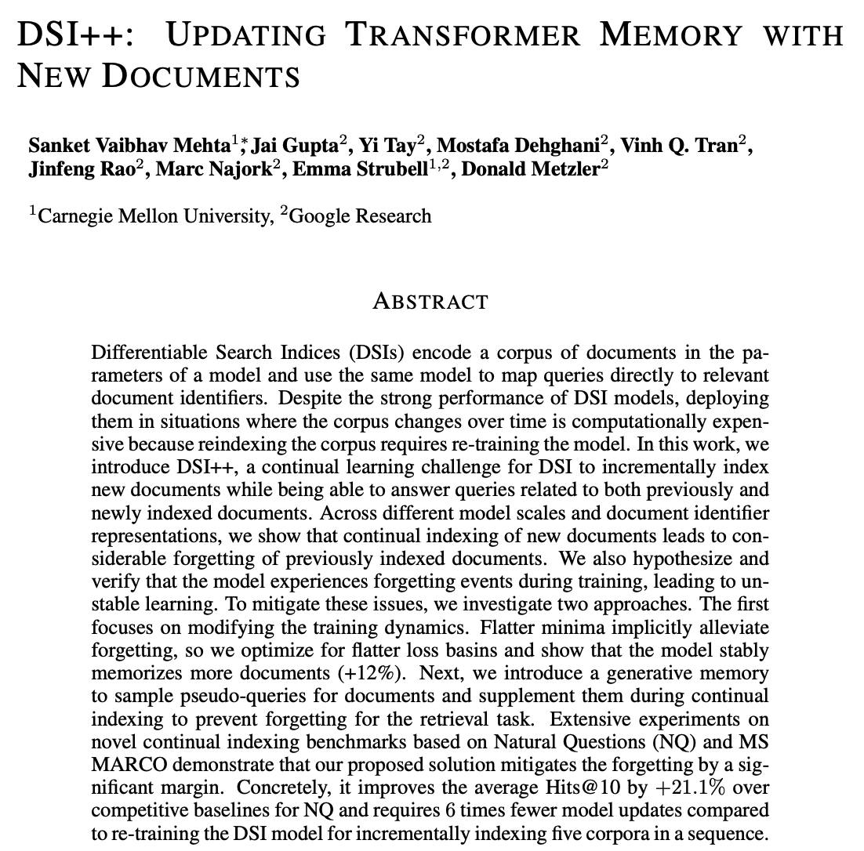
Challenge: Adding new documents to DSI
Approach: Incorporate new documents into DSI model via continual learning
Challenge: Naively learning new documents leads to catastrophic forgetting of old documents
Analysis revealed both implicit forgetting during memorization of base corpus and explicit forgetting during continual learning
arXiv 2022, https://doi.org/10.48550/arXiv.2212.09744
Notes:
As we have just seen, DSI is effective at attributing answers to sources – one of the four challenges in designing an closed-book generative QA system. The second challenge is how to deal with changes in the underlying corpus. For a web-scale corpus, it is simply not feasible to train a new language model from scratch whenever the corpus is updated. The obvious solution is to use some form of continual learning – continue training the model whenever new documents arrive. Unfortunately, this leads to catastrophic forgetting of older documents – a problem that simply does not exist in more conventional IR systems. We analyzed the nature of these forgetting events and found two root causes: implicit forgetting, where the model forgot previous training examples even while memorizing the base corpus, and explicit forgetting, where the model forgot training examples from prior versions of the corpus while incorporating a new bundle of updates delivered by the the crawling component.

Slide 38
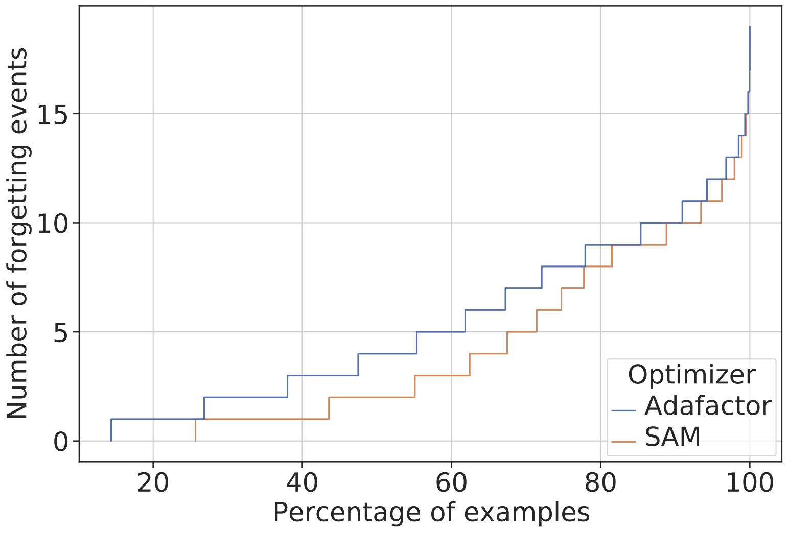
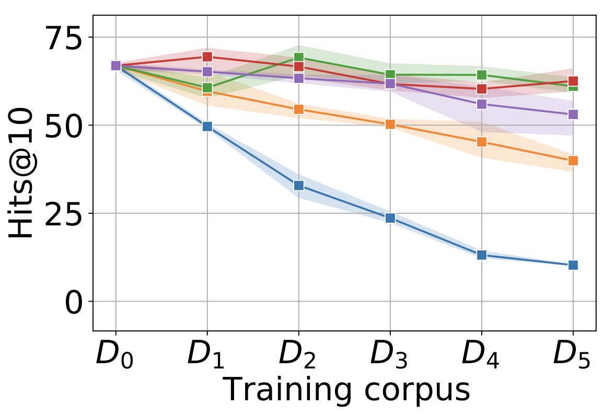
Avoiding catastrophic forgetting when updating DSI
Can ameliorate implicit forgetting by using Sharpness-Aware Minimization for loss function [Foret et al 2021, Bahri et al 2022]
Can alleviate explicit forgetting via forward transfer: generate pseudo queries to surface previously learned documents, and add these documents to training batches of fresh documents (“generative memory”, Mocanu et al. 2016)
Evaluated on Natural Questions dataset and MSMARCO dataset
Take-aways: Using SAM is moderately effective at stemming implicit forgetting; using generative memory is extremely effective at preventing explicit forgetting
Notes:
As it turns out, we can ameliorate implicit forgetting by optimizing for flatter loss basins using Sharpness-Aware Minimization, a technique proposed by Pierre Foret and others in 2021 and applied to language models by my colleague Dara Bahri and others to language models in 2022.
To alleviate explicit forgetting, we are using an old idea from reinforcement learning called experience replay: presenting the learner with training examples it has seen previously. In particular, we generate pseudo queries to surface documents that were previously learned, and feed these documents back as training examples along with the new documents.
We evaluated these two fixes to forgetting on two datasets, Natural Questions and MSMARCO. The key takeaway is that SAM is SAM is moderately effective at stemming implicit forgetting; and using generative memory is extremely effective at preventing explicit forgetting.
SKIP THIS TO SAVE TIME:
The diagram at the bottom left shows the effect of using Sharpness-Aware Minimization. As you can see, compared to the Adafactor optimizer, SAM causes consistently fewer events of forgetting previously seen training examples as new examples are learned by the model. The diagram on the right shows how the Hits@10 metric – the fraction of queries for which DSI retrieves the correct document among the top 10 – evolves as the index is updated with fresh document bundles. The blue curve shows naive continuous learning, the purple curve shows the baseline of reindexing the entirety of seen documents from scratch (which is unrealistic due to the computation cost), and the green and red lines shows the effect of using generative memory, with two different parameterizations. As you can see, generative memory outperforms both the naive baseline of continuous learning and the unrealistic baseline of reindexing everything from scratch.

Slide 39
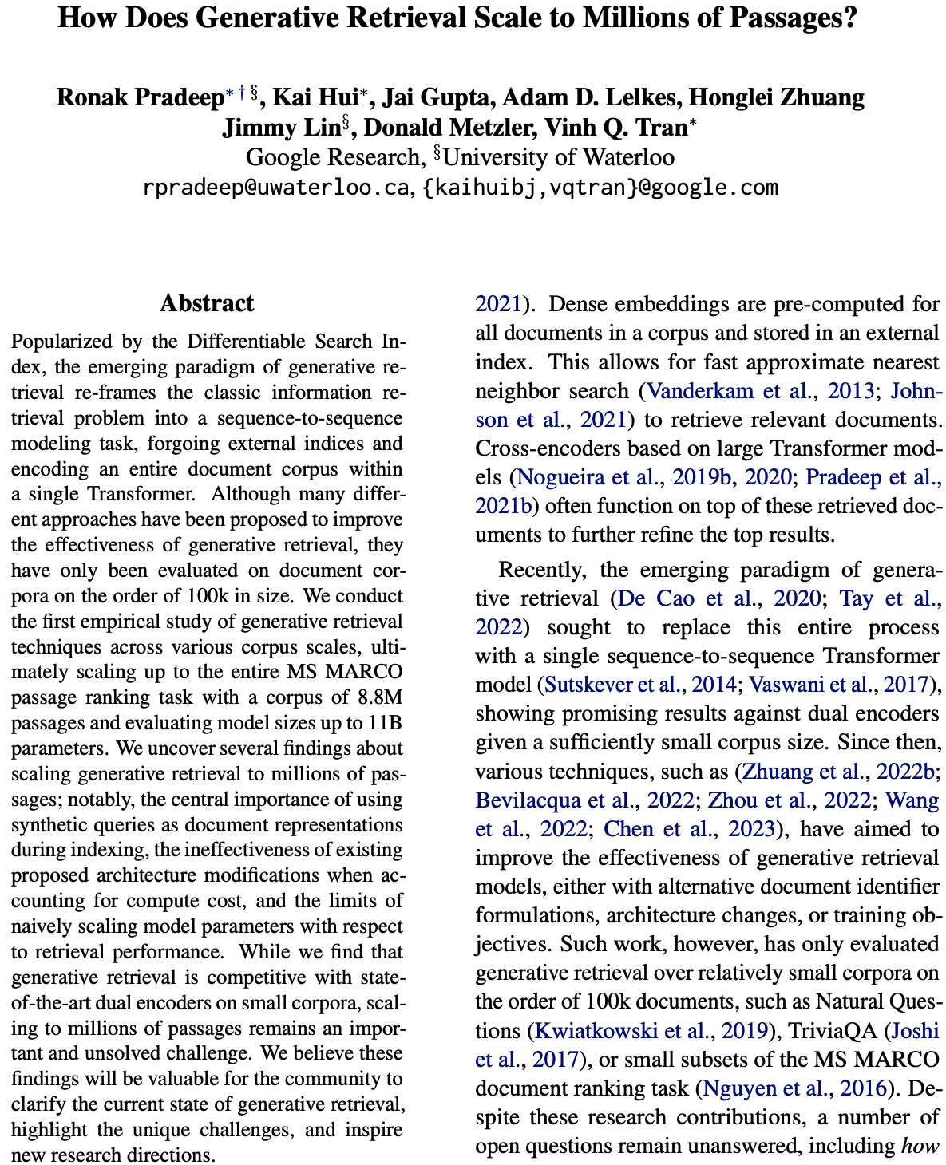
Challenge: Scaling DSI to large collections
Original DSI paper: corpora of O(10k) to O(100k) documents
This paper: Corpus of O(10m) documents
Key finding is that using synthetic queries (with documents being the prompts) during index learning is most important
Scaling to web-scale corpora remains an unsolved problem
arXiv 2023, https://doi.org/10.48550/arXiv.2305.11841
Notes:
The third challenge is scaling DSI to large collections. The original experiments were run on modestly-sized collections – tens of thousands to hundred of thousands of documents. Recently, my colleagues studied how to scale DSI up by two orders of magnitude. The key finding is that using synthetic queries – produced by a generative model – are the most important ingredient for scaling up DSI. That being said, scaling up to billion document corpora remains an unsolved problem.

Slide 40
Architecture of a closed-book generative QA system
off-line / crawl-time
on-line / query-time
Content
Crawler
LM Trainer
Language Model
LM Generator
Search Front End
Users
Pure generative question-answering system
Notes:
To wrap up the discussion of closed-book generative question answering systems, here is the architecture of such a system. As you can see, it is conceptually extremely simple – the language model is the only store of knowledge, updated by the offline component and used for generation by the online component. But let me clarify once again that we have not actually used DSI for generation so far, so as far as DSI is concerned this is still “future work”.

Slide 41
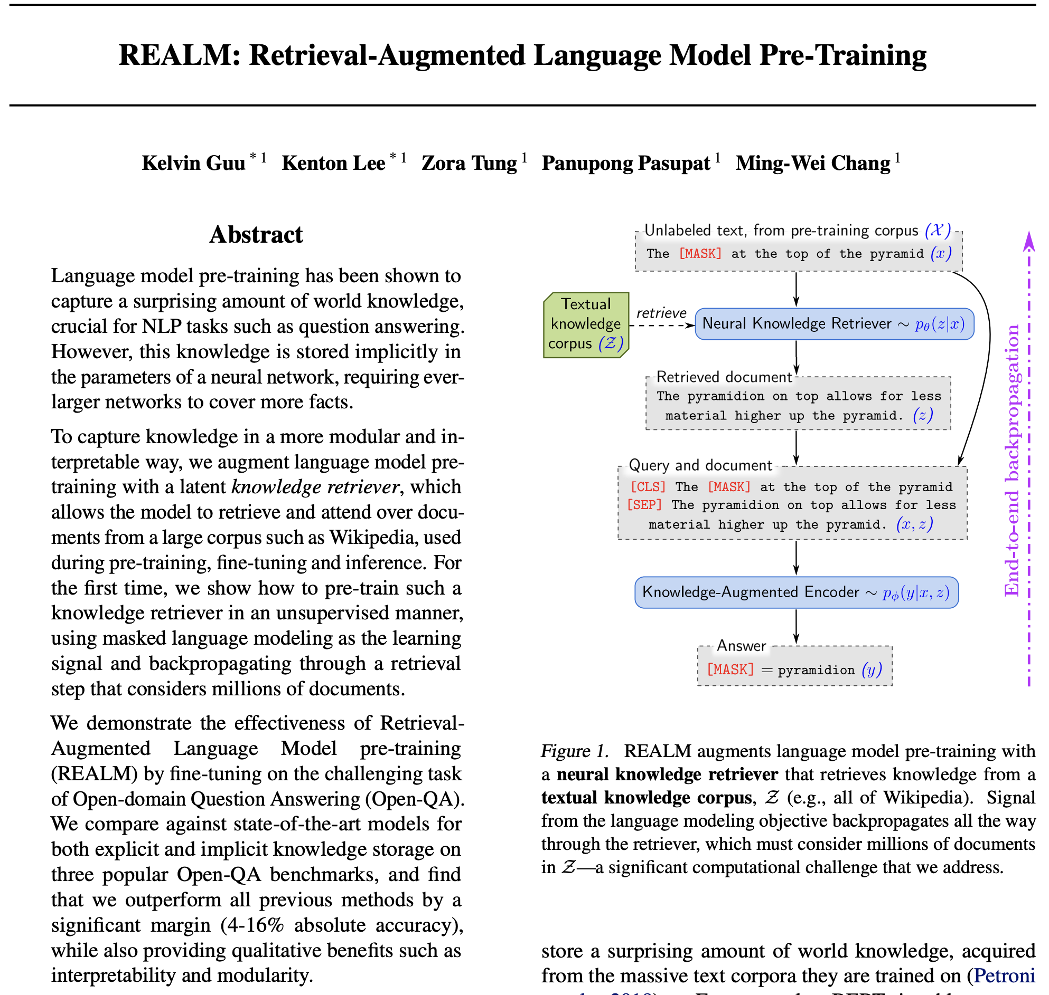
Alternative B: Open-book generative question answering
Non-generative precursor: REALM
Given a question, use an external memory (“knowledge retriever”, BERT & ScaNN) to retrieve a set of potentially relevant documents, and extract answer from question and documents (“knowledge-augmented encoder”, span prediction using BERT)
System (KR and KAE) optimized end-to-end
Evaluated on multiple open-domain question answering benchmarks
ICML 2020, https://dl.acm.org/doi/pdf/10.5555/3524938.3525306
Notes:
The alternative to closed-book question answering is open-book question answering, where the generative model can draw on external memory prior to, during and after generation. In 2020, colleagues at Google described a recursor of such a system called REALM. REALM performs extractive as opposed to generative question answering. It has two components, a retriever and an extractor. Given a question, REALM maps the question to an embedding using BERT. It retrieves a set documents that are similar to the query using ScaNN. Next, it uses a span prediction model (again based on BERT) to identify the most relevant passage in each retrieved document, and returns the overall most relevant passage. It’s important to stress that both the retriever and the extractor/ranker are differentiable and can therefore be jointly optimized. REALM was evaluated on multiple open-domain QA benchmarks and did well; please read the paper for details.

Slide 42
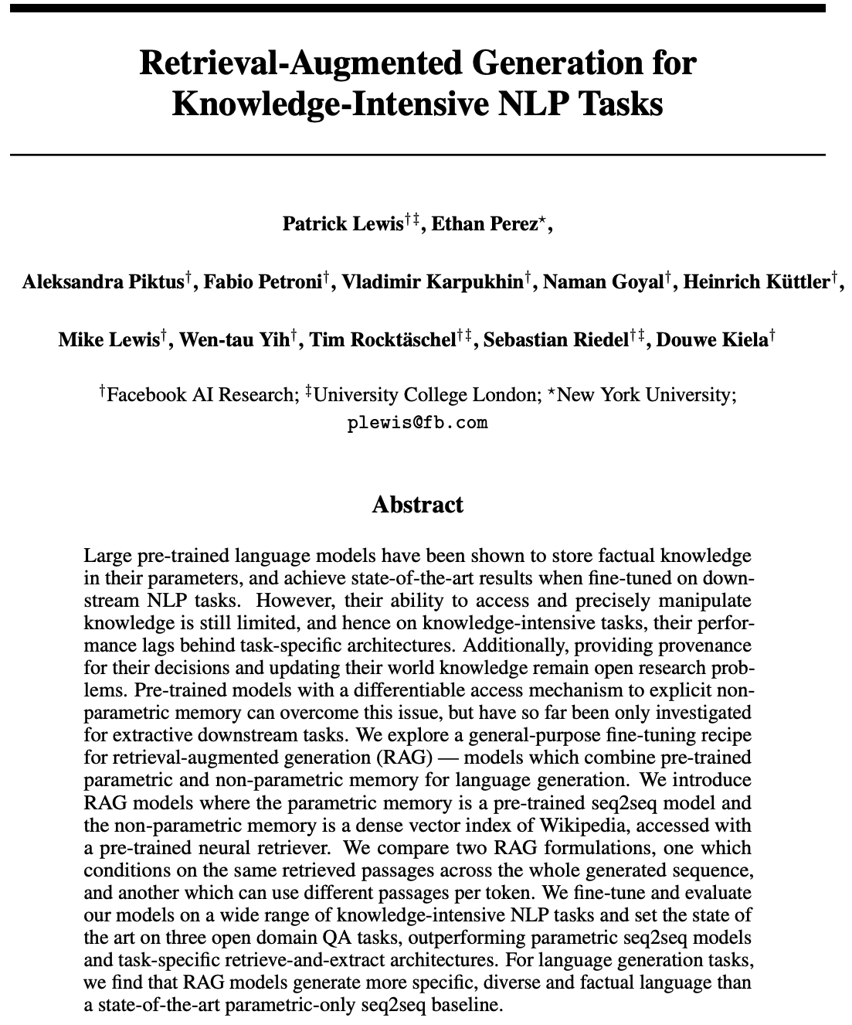
Alternative B: Open-book generative question answering
Retrieval-Augmented Generation (RAG)
Two components: retriever (like REALM) and generator (analogous to REALM extractor). As in REALM, both components are jointly learned.
Retriever: passage (not document) retriever, using BERT and FAISS (DPR system)
Generator: BART (FB encoder-decoder LM)
Separate generation for each question- passage pair, producing a set of answers (“hypotheses”); return the most likely answer
NeurIPS 2020, https://proceedings.neurips.cc/paper/2020/file/6b493230205f780e1bc26945df7481e5-Paper.pdf
Notes:
Inspired by REALM, a team at FAIR built and tested a generative equivalent, which they called Retrieval Augmented Generation or RAG for short. RAG has a neural retriever just as REALM does, but while REALM retrieved entire documents and then performed passage extraction as a separate step, RAG does passage segmentation at indexing time and passage retrieval at query time. Each candidate passage is fed (along with the query) to the generator, the generated answers are ranked according to their predicted relevance, and the most likely answer is returned. Again, it’s worth emphasizing that all parts of RAG can be jointly optimized.

Slide 43
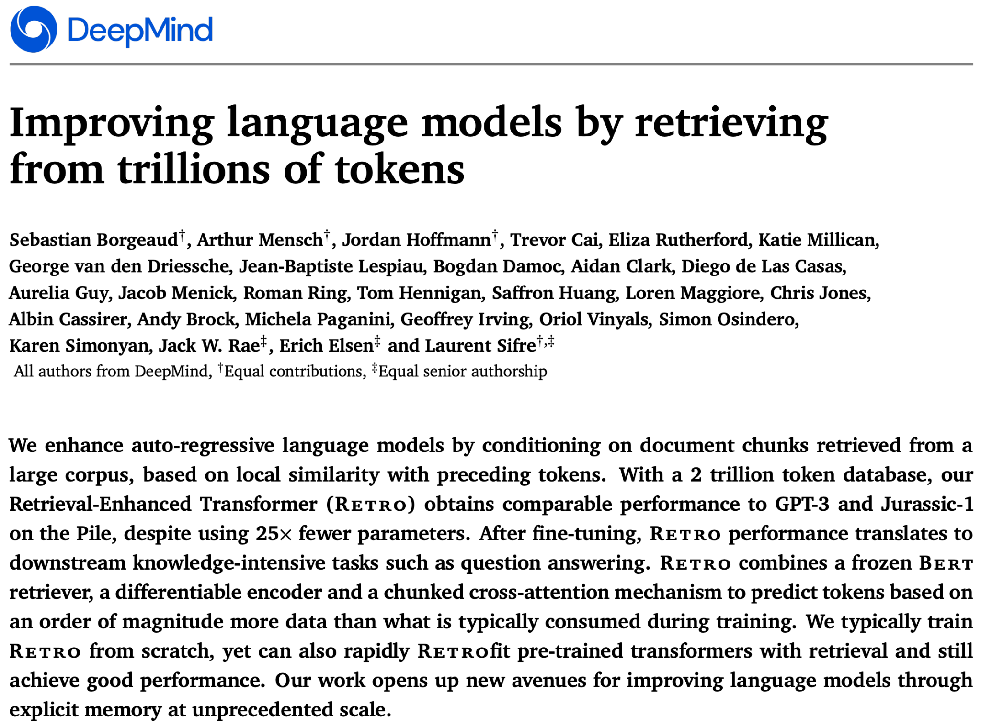
Alternative B: Open-book generative question answering
RETRO: Retrieval-augmented generative model
External memory 1000x larger than in REALM and RAG
Generator processes question and retrieved docs/passages separately (cross-attention) – possibility for repeated retrievals during generation
arXiv 2021, https://arxiv.org/abs/2112.04426
Notes:
Retrieval-augmented generation use external memory to guide the generation process – in other words, it leverages both parametric and non-parametric knowledge. In REALM and RAG, parametric and non-parametric knowledge are not coupled – the generative model is trained without leveraging the retrieval mechanism. Colleagues at DeepMind explored bringing retrieval into the training process. In RETRO (which stands for Retrieval-Enhanced Transformer), documents in the training data are chunked into sentence pieces and stored in a lookup table keyed by their BERT embedding. During training, a sentence piece is enhanced by neighboring sentence pieces in the embedding space. During retrieval, RETRO uses an external memory that has about an order of magnitude more data than was used during training. It generates responses in a chunked fashion, starting from the prompt. It. For each chunk, it retrieves neighboring sentence pieces from external memory to augment the input, generates a response chunk, and iterates. The RETRO paper introduces a number of novel ideas regarding maintaining causality during training and avoiding test-set leakage during evaluation.For more details, I refer you to the paper.

Slide 44
Architecture of a retrieval-augmented GQA system
off-line / crawl-time
on-line / query-time
LM Trainer
Language Model
LM Generator
Corpus Builder
Corpus
Corpus Server
2
Content
Crawler
3
Search Front End
Users
Document
Embedder
Vector DB
Embedding Server
1
1
Index Builder
Inverted Index
Index
Server
Retrieval-augmented generative question-answering system
Notes:
Both REALM and RAG used semantic indices as their retrieval component. This has the advantage that retrieval and answer extraction or generation can be jointly optimized, but at this point it does not scale to trillion document corpora. We can augment the semantic retrieval with a lexical retrieval component to obtain a hybrid retriever, and we can still jointly optimize the semantic retrieval model and the result fusion model with the generative model. Here is a high-level diagram of such a system.

Slide 45
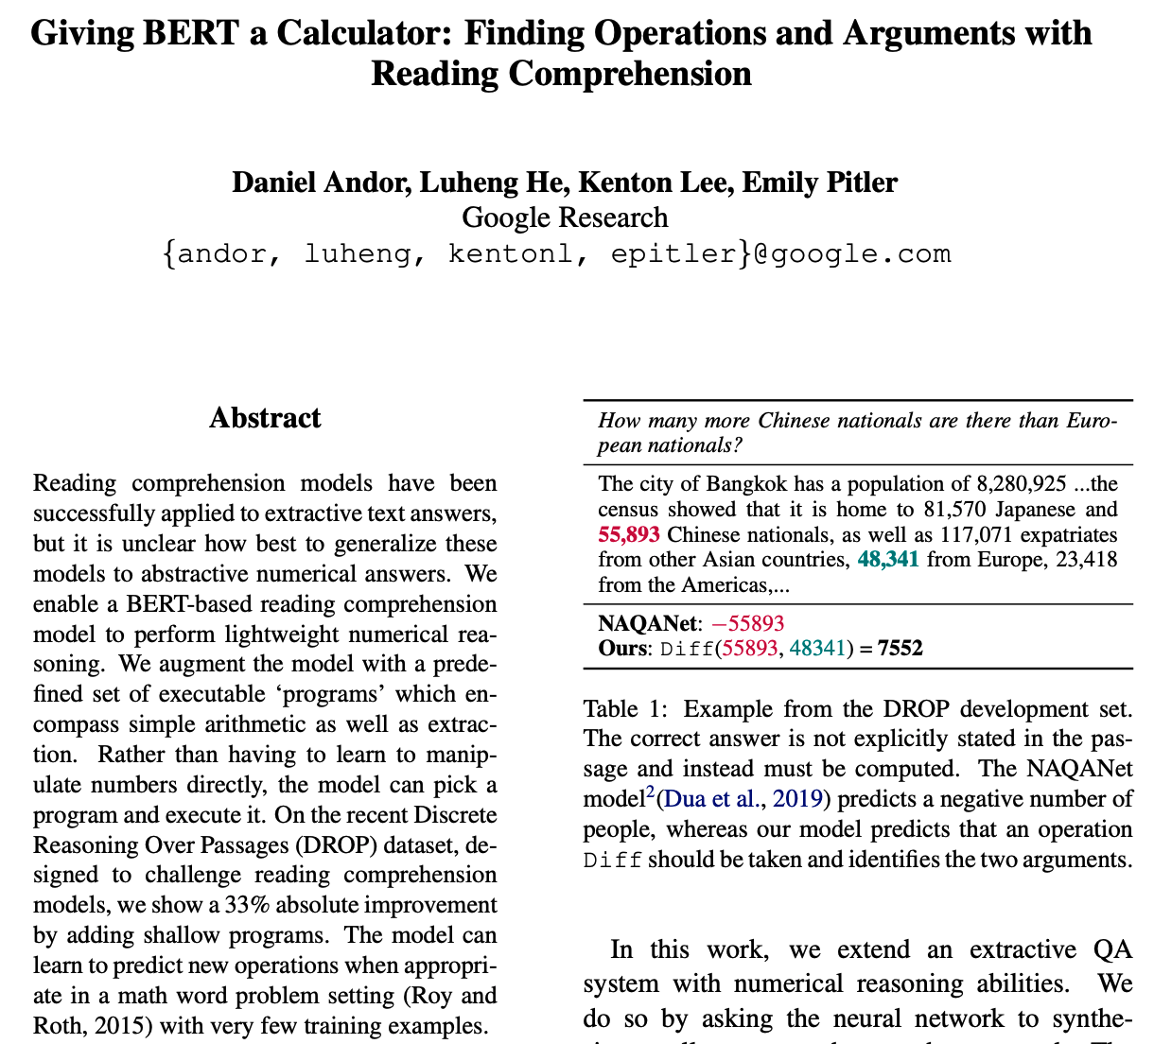
Knowledge beyond memorization
Language models are good at memorizing, not good at arithmetic
Idea: teach language model to invoke calculator – extract operands (e.g. from a retrieved document) and select operator
Evaluated on DROP dataset (co-trained on CoQa); 50% relative improvement over previous SotA
EMNLP / IJCNLP 2019, http://dx.doi.org/10.18653/v1/D19-1609
Notes:
Language models are excellent at memorization, but are not capable of performing what we could call algorithmic reasoning – for example, learning the algorithm for long division and then performing it at inference time. As a result, they are not good at arithmetic reasoning – say, subtracting the population of Paris from the population of France to answer the question “how many french residents don’t live in Paris?”. So, colleagues at Google had the idea to teach language models how to use external tools, such as a calculator. The basic idea is to teach the model to extract numerical quantities – the operands – from a prompt, and to train the model to invoke the correct operator. This works amazingly well – the approach produced a 50% improvement on the previous state-of-the art on DROP (which stands for “Discrete Reasoning Over Passages”), a reading comprehension task where many questions require arithmetic reasoning.

Slide 46
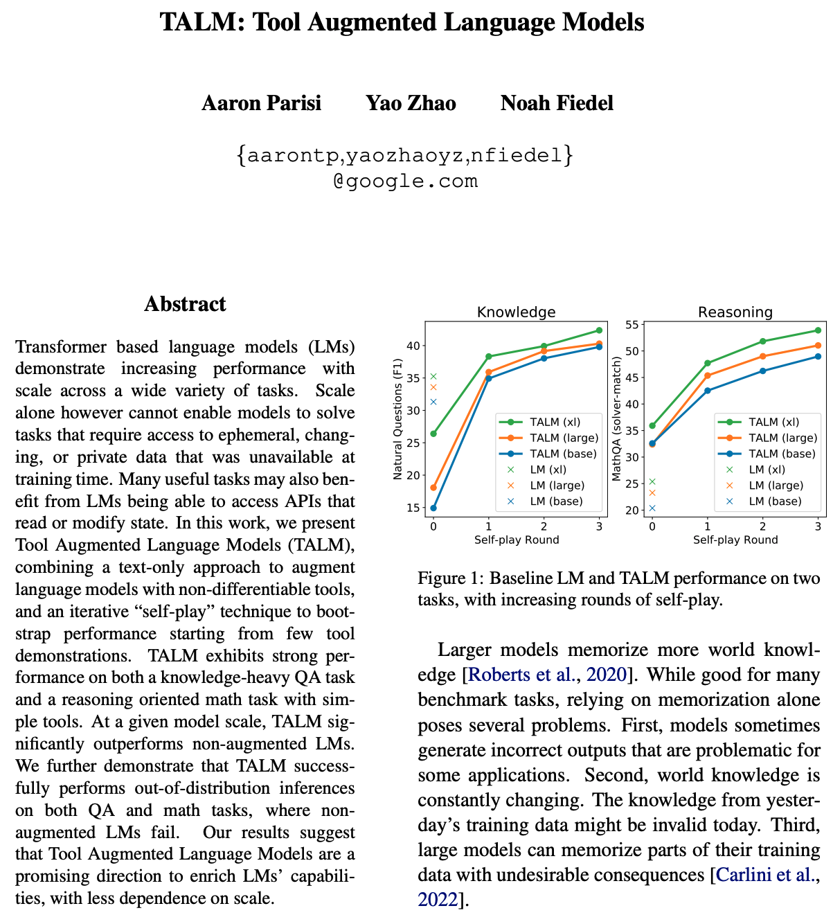
Generalization: Tool-augmented generation
Calculators are an instance of “tools” – non-differentiable subsystems that can be leveraged by a language model (lexical retrieval system another example)
Learn to translate question x to tool invocation t, tool result r to answer y
Iterative self-play: given a small amount of (x,t,r,y) tuples for bootstrapping and a large number of (x,y) pairs, learn two text-to-text mappings
Can be used to interface with reasoning engines such as Wolfram Alpha
arXiv 2022, https://doi.org/10.48550/arXiv.2205.12255
Notes:
A different set of colleagues at Google generalized the core idea of the previous work: teaching language models how to use black-box tools. In this context, a tool is a non-differentiable subsystem that takes inputs and produces outputs. Examples include symbolic reasoning systems such as Macsyma or Mathematica, or black-box retrieval systems such as the SABRE flight reservation system. A core assumption is that the tool has a finite and manageable set of operations that can be explored in a brute-force fashion. The learning task is to map a question to a tool input, and a tool output to an answer. This is done by bootstrapping the system on a small data set of (question, tool-input, tool-output, answer) exemplars, and then continuing the training on a much larger dataset of (question, answer) pairs, where the system will discover the appropriate input and output mappings through iterative self-play, an approach grounded in reinforcement learning.

Slide 47
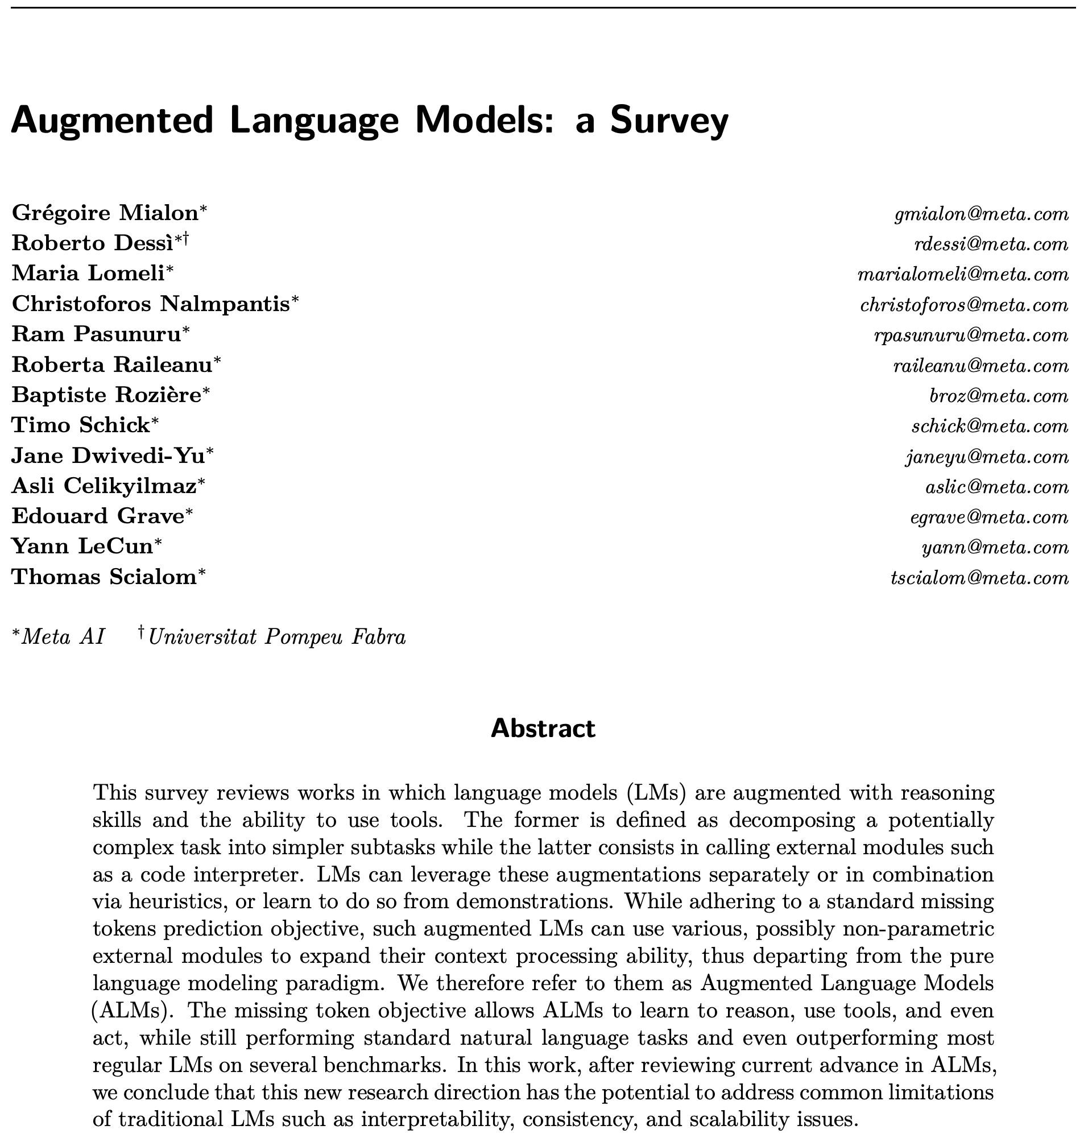
Further reading on Augmented Language Models
arXiv 2022, https://arxiv.org/abs/2302.07842
Notes:
If you would like to learn more about the current state of the art in retrieval-augmented and tool-augmented language models, I recommend this very comprehensive survey that was recently published by researchers at Meta. My meta-takeaway from this article is that language models are the new “middleware” – they allow the various components in a knowledge system to interoperate, they are the glue that holds everything together.

Slide 48
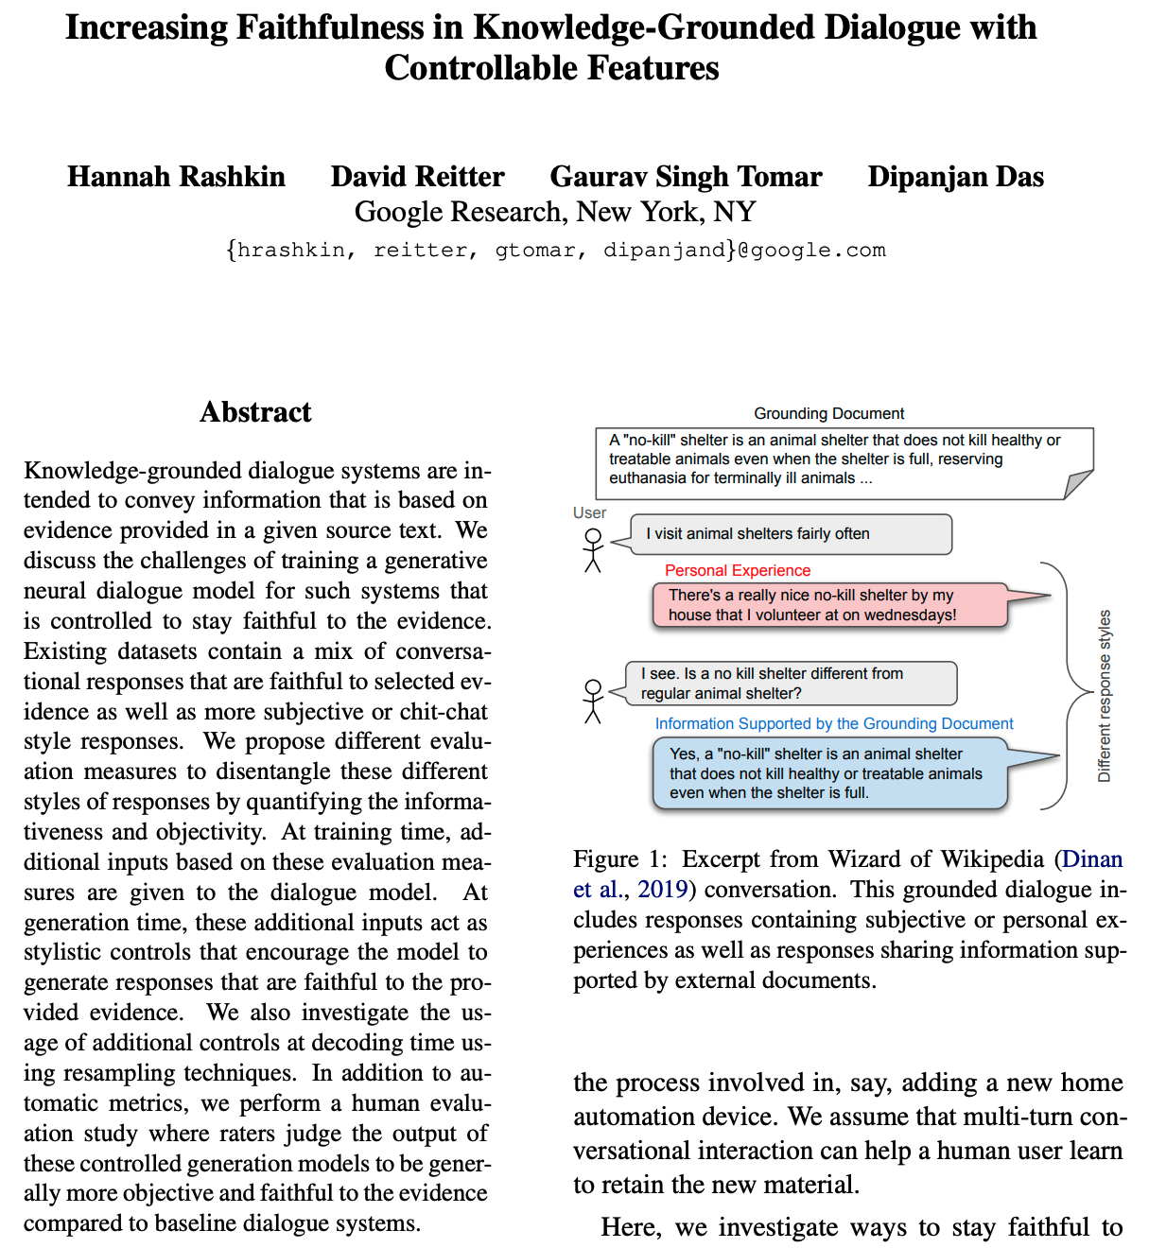
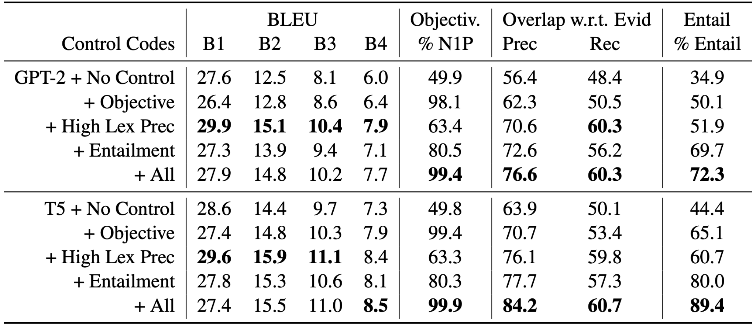
Key challenge: Faithfulness of answers
Can generative models be taught to return objective, well-grounded and faithful answers?
Three desired properties: objective voice, lexical similarity between answer and evidence, entailment
Fine-tune seq2seq model (GPT-2, T5) on training data with control codes for these properties
During inference, add codes for desired behavior to prompt
Fine-tuned model vastly outperforms base model
ACL / IJCNLP 2021, http://dx.doi.org/10.18653/v1/2021.acl-long.58
Notes:
Ideally, generative question answering systems should be truthful. But truth is an elusive concept, so we will settle for such systems to be faithful – that is, answers should be entailed by evidence retrieved from a corpus, and hopefully the evidence comes from authoritative sources. In this paper, colleagues at Google define the concept of knowledge-grounded dialogue. The authors propose three desiderata: generated answers should be written in an objective voice (as opposed to personal anecdotes), they should have high lexical overlap with the underlying evidence, and they should be semantically entailed by the evidence. They fine-tuned two pre-trained seq2seq models (GPT-2 and T5) on a grounded-generation dataset, teaching the models to understand control tokens for each of the three desiderata. During inference, they added control tokens for the desired behavior to the prompt. In a human evaluation on the “Wizard of Wikipedia” dataset, the system performed much better than the baseline pre-trained models.

Slide 49
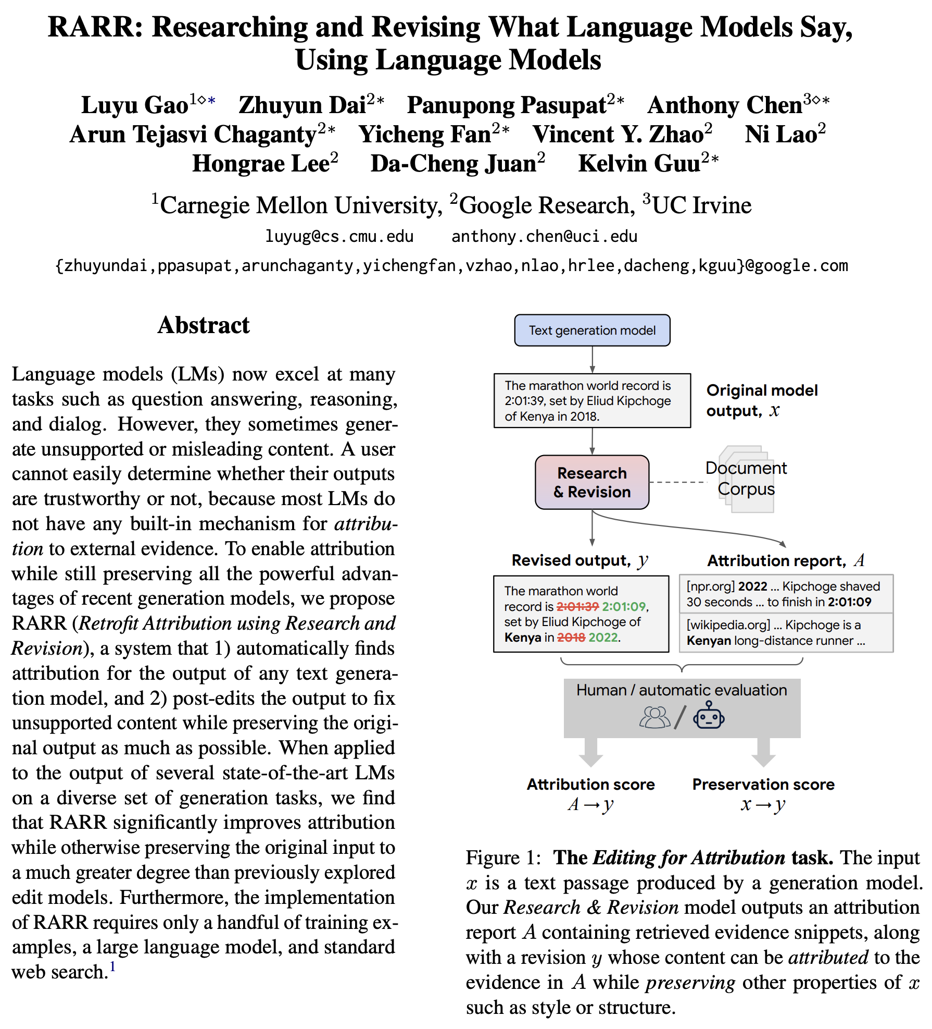
Key challenge: Attribution of answers
Retrofit Attribution using Research and Revision (RARR): Aligning generated answers with passages in source documents. Given a generated passage x, three stages:
Research stage: generate a set queries q_{i} from (all parts of) x and retrieve evidence passages e_{ij}
Revision stage: check if x disagrees with any e_{ij}, revise x until done
Attribution stage: Annotate the portions of x with selected e_{ij}
arXiv 2022, https://arxiv.org/abs/2210.08726
Notes:
But what to do if the generated answer is not entailed by evidence? In this paper, colleagues at Google develop a mechanism they call “Retrofit Attribution using Research and Revision” or RARR for short that actively corrects ungrounded generated text. It does so in three stages: first, it uses a subsystem called “Comprehensive Question Generation” (CQGen) to generate a set of queries that cover all aspects of the given generated text; then it uses a standard retrieval system (Google) to obtain responsive documents, followed by extraction of the most relevant passage from each document. Then, RARR checks whether any of these passages disagrees with aspects of the generated text, and edits the text until there is no disagreement left. Both the agreement model and the edit model are in turn leveraging a generative model (PaLM).

Slide 50
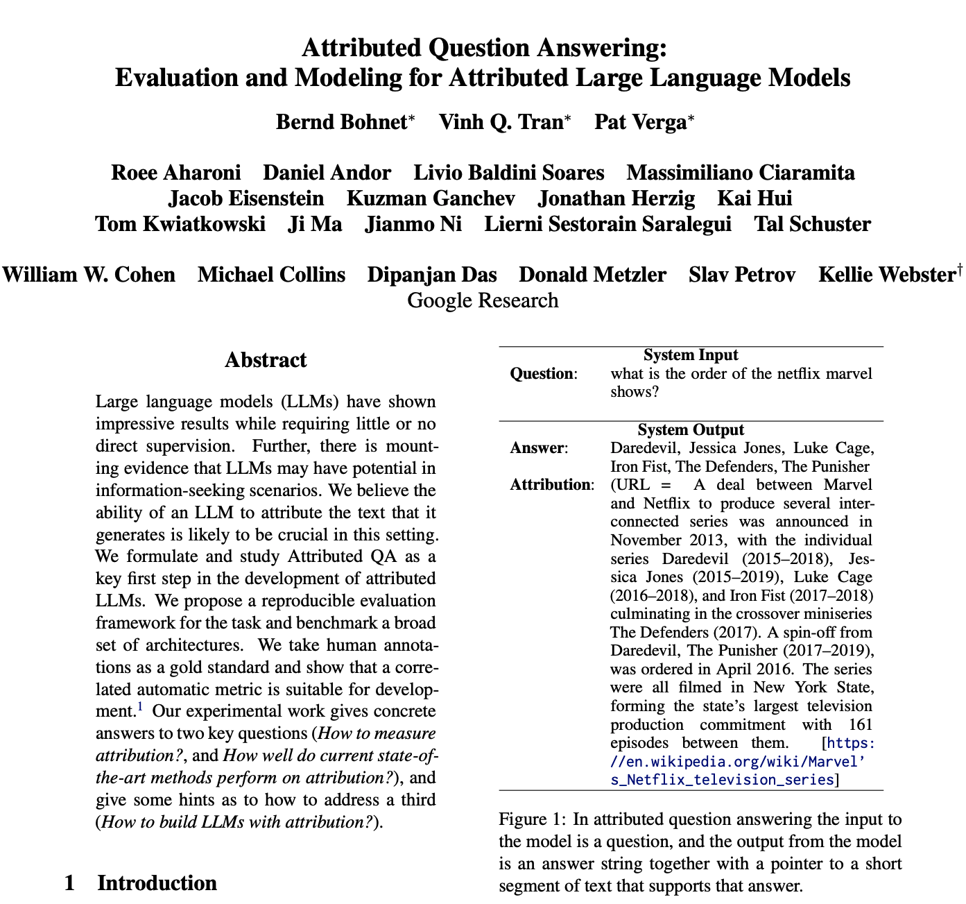
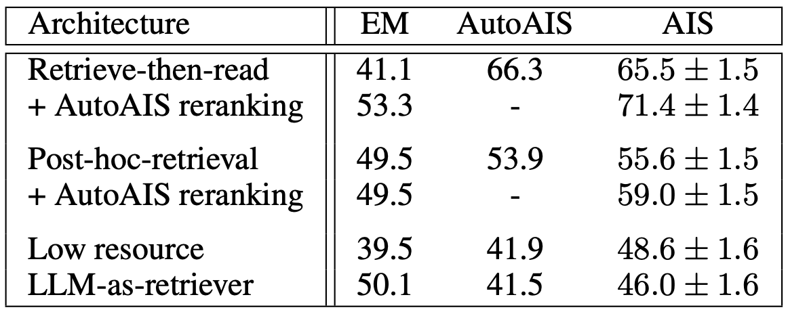
Key challenge: Attribution of answers
Benchmarking attribution in generative QA
Three metrics:
Exact Match (algorithmic)
Attributable to Identified Source (AIS, human)
AutoAIS (automatic)
Three classes of GQA systems:
Retrieve-then-Read (e.g. RAG, RETRO)
Post-hoc retrieval (e.g. RARR)
LLM-as-retriever (e.g. DSI, NCI)
Retrieval-augmented generation performs best
arXiv 2022, https://doi.org/10.48550/arXiv.2212.08037
Notes:
As we argued in “Rethinking Search”, generative question answering should be transparent – answers should contain references to sources supporting the answer. In this paper, colleagues at Google formulate the attribution problem – namely, given a question, the system returns both an answer and an attribution, a reference to a source for that answer. The propose a framework for reproducible evaluations, with evaluation by humans as the gold standard and automatic evaluation (leveraging what was used in the RARR paper) for scaling out. They use this framework to evaluate three classes of generative QA systems: “Retrieve-then-Read” (such as RAG and RETRO), “Post-hoc-Retrieval” (in the spirit of RARR), and LLM-as-retriever (such as DSI and NCI). They use parts of the Natural Questions dataset, Wikipedia as the corpus, and Exact Match, AIS (which stands for Attributable to Identified Sources) and AutoAIS as the metrics. Perhaps not surprisingly, they find that retrieve-then-read systems perform best, so retrieval-augmented generation is still the best approach to generative question answering.

Slide 51
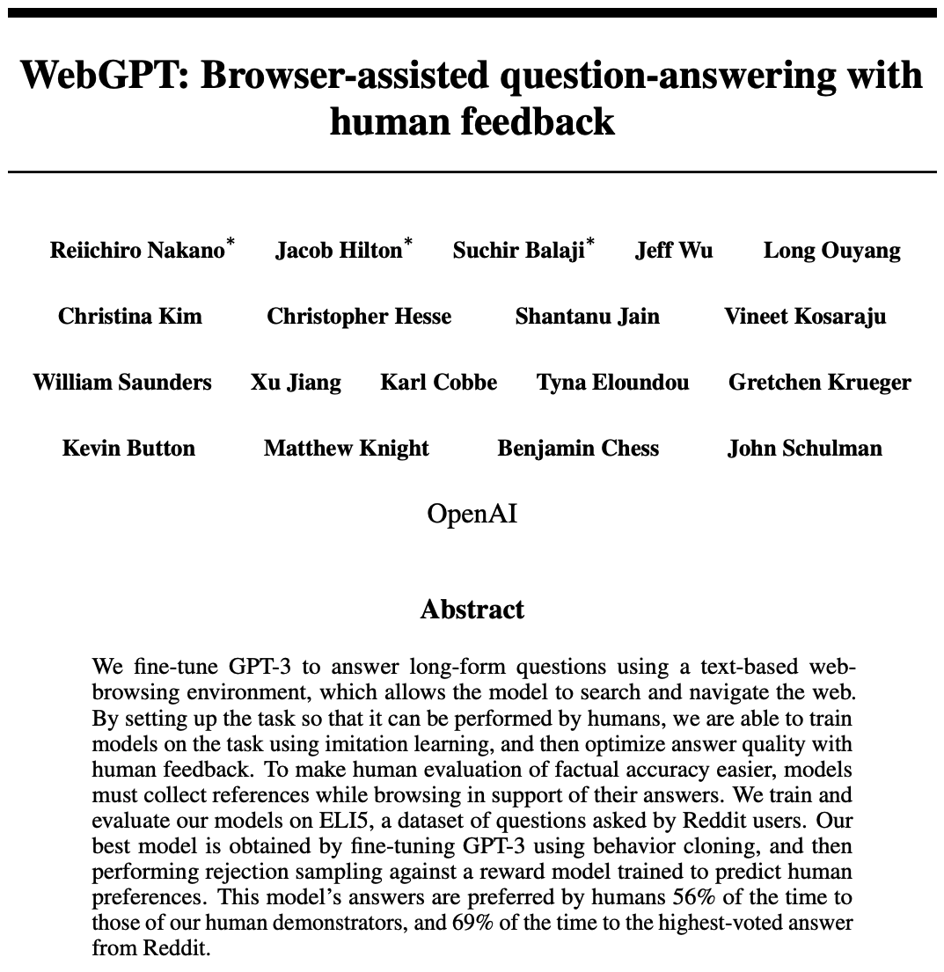
Meanwhile, at OpenAI …
Key take-aways:
Web-based system for long-form question answering
Retrieval-augmented generation, using Bing search API
Uses GPT-3 as the pre-trained language model
Fine-tuned using Reinforcement Learning with Human Feedback (RLHF): human- written answers (“demonstrations”) and human pairwise assessments (“comparisons”)
Answers have references (attribution)
Foreshadowed ChatGPT (but got far less attention)
arXiv 2021, https://doi.org/10.48550/arXiv.2112.09332
Notes:
In December 2021, OpenAI published a paper on WebGPT. WebGPT is a system for long-form question answering, using GPT-3 as the generative model and the Bing web search API as a retriever. WebGPT is tightly integrated into a web browsing environment, and can act a search companion. Paid workers are given a question and asked to search the web to find potential answers and then to write an answer. These searches and answers are called demonstrations and are used to train WebGPT to do the same. Independently, WebGPT is given a question and asked to generate two alternative answers, and (different) paid workers are asked to compare the two answers and select the better one, providing a different category of training data. Since comparison is much easier for humans that demonstration, it is possible to generate far more comparison examples than demonstration examples. Collectively, this approach is known as reinforcement learning with human feedback, and it has become a key ingredient in training generative question answering systems. WebGPT predated ChatGPT by about one year, but received only limited attention outside of the machine learning community.

Slide 52
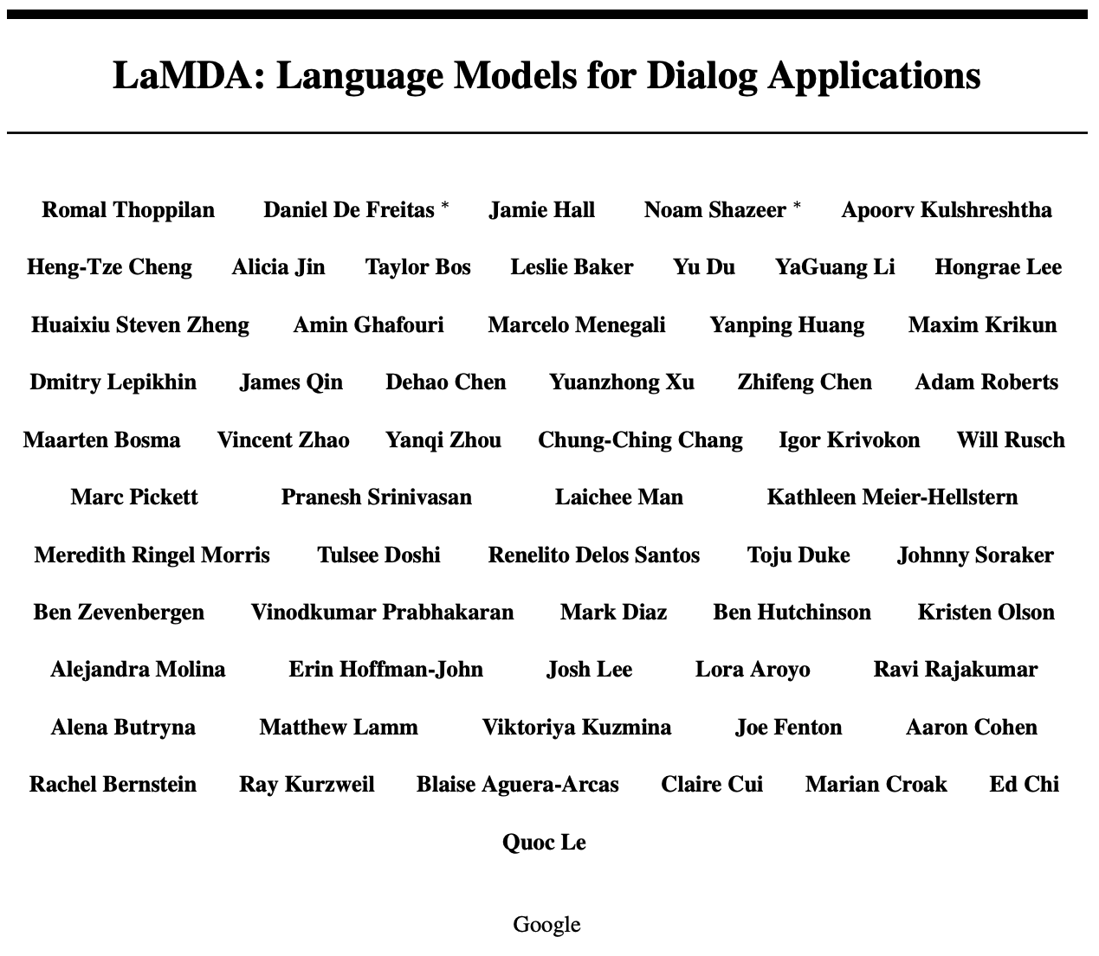
… and Google Research
Large (up to 137B parameters) language model for dialog applications; decoder-only architecture
Fine-tuned for sensibility, specificity, interestingness, safety, factuality, tool augmentation, multi-hop QA
Foreshadowed Bard
arXiv 2022, https://doi.org/10.48550/arXiv.2201.08239
Notes:
A month later, colleagues at Google (a great number of them) published a paper on LaMDA, a large language model that was specifically designed for dialog applications. LaMDA is a family of models of varying sizes. It is trained for both generative and discriminative tasks.Given a question, it generates potential responses, which are then filtered for safety, grounded on an external knowledge source, and re-ranked to find the highest-quality response. The team introduced a number of key objectives for dialog systems: quality metrics including sensibleness, specificity, and interestingness; safety metrics; groundedness metrics; informativeness metrics; and citation accuracy metrics. LaMDA was fine-tuned to predict these metrics, making it possible to prompt for the desired behavior in a generative setting. LaMDA foreshadowed Bard by about 15 months.

Slide 53
Generative Models and the Web Ecosystem
Notes:
In the final chapter of this talk, let us take a step back and consider how generative language models and generative question answering will affect the web ecosystem as a whole, and search engines in particular.

Slide 54
Effects of Generative AI on web and search ecosystems
Content farms will employ generative models instead of human writers
What if generated content is used to train the next LM?
“Hall of mirrors” effect
Direct answers reduce search referral traffic
Mostly affecting informational queries
Content providers rely on referral traffic from search engines
Pressure to develop alternative revenue streams
Direct answers will affect engagement with search engines
Users can get more answers directly, less outbound traffic
Increased focus on informational-to-transactional journeys
Notes:
It is difficult to predict the full impact of generative models on the web ecosystem, but some of these changes are easy to predict because they have already started to play out.
Generative language models will change the nature of authorship. Writers will use generative models to assist them in crafting fluent prose. That is not a bad thing – writing fluent prose is a service to the reader. Problems arise when generative content is produced wholesale, without a human editor in the loop. Today, there is an entire industry of “content farms” that employ low-wage workers to churn out content that is well-monetizable. I predict that this industry will be among the first to embrace wholesale no-human-in-the-loop content creation, and in the process will flood the web with lots of synthetic content that may or may not be factual. If we used that content to train the next generation of language models, bad things could happen. In the limit, it might lead to “model collapse” – more on that later.
Second, direct answers have the potential to reduce search engine referrals – the traffic that comes from searchers clicking on a result link. Content creators need to make a living, and often this living comes from bundling what is useful to the user with what is useful to the content provider. In other words, it relies on traffic to their site. It is to everyone’s benefit if content creation remains a viable business, and that may mean that business models need to evolve.
Finally, direct answers will affect how users interact with search engines themselves. Users are less likely to leave the search engine while on their information-seeking journey; on the other hand, journeys may go farther and deeper due to the lowered Delphic Cost. I expect there will be an increased focus on longer and deeper journeys, including journeys that move from information-gathering to act-upon-information stages.

Slide 55
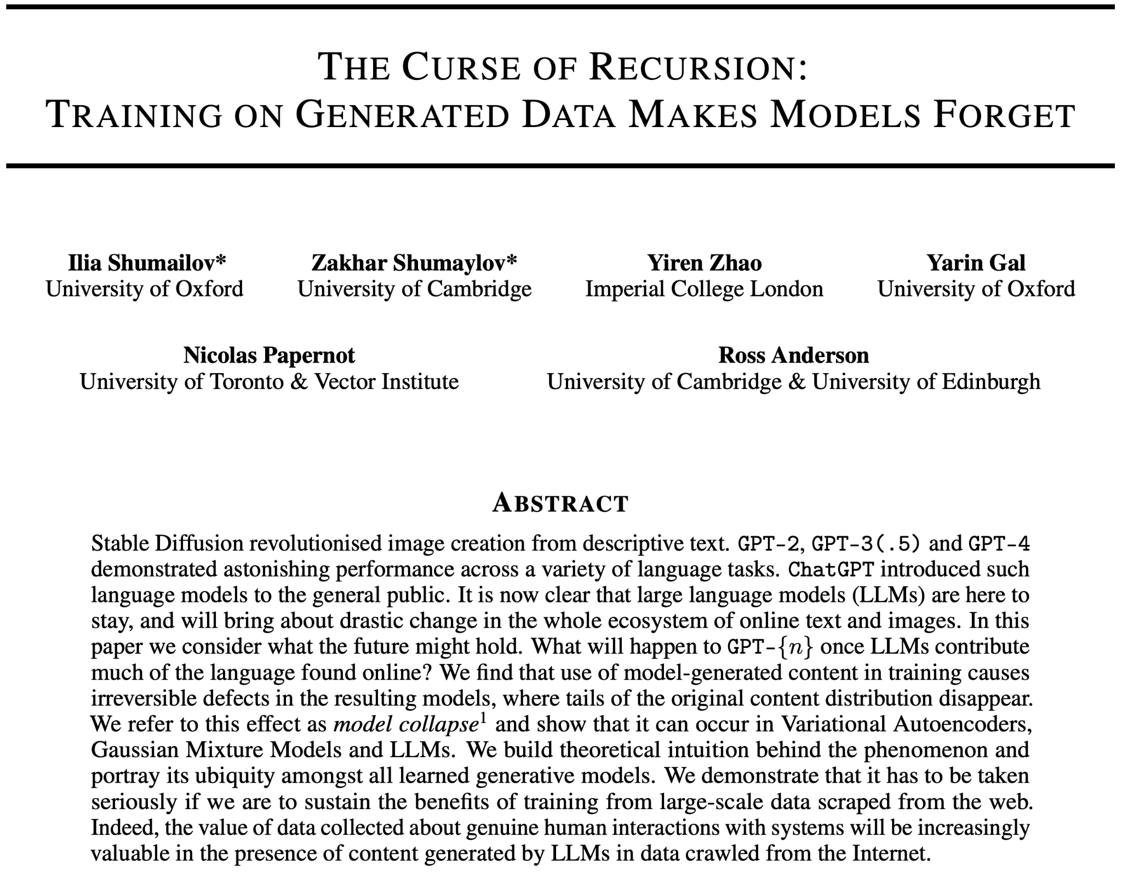
Training on generated content leads to model collapse
Very recent study shows that training on large swaths of generated content causes “model collapse”
Two expressions: early model collapse and late model collapse
Two root causes: statistical approximation error and functional approximation error
Inherent limitation to recursive training of generative models
arXiv 2023, https://arxiv.org/abs/2305.17493
Notes:
In a paper that was published just two months ago, a group of researchers examined what using generated content to train successor models would mean to the quality of of these successor models. They empirically show that many different families of generative models suffer from “model collapse” when recursively trained on their own output. They find that there are two expressions of this phenomenon: early model collapse, where recursive training causes the model to lose information about the tails of the distribution, and late model collapse, where the model converges to a distribution that carries little resemblance to the original model. The postulate two root causes: statistical approximation error, which is caused by the discrete nature of sampling training examples, and functional approximation error, which is a function of the expressivity of the model. The take-away from this paper is that human-authored training data is essential to training generative language models, and that we need a mechanism to “separate the wheat from the chaff”.

Slide 56
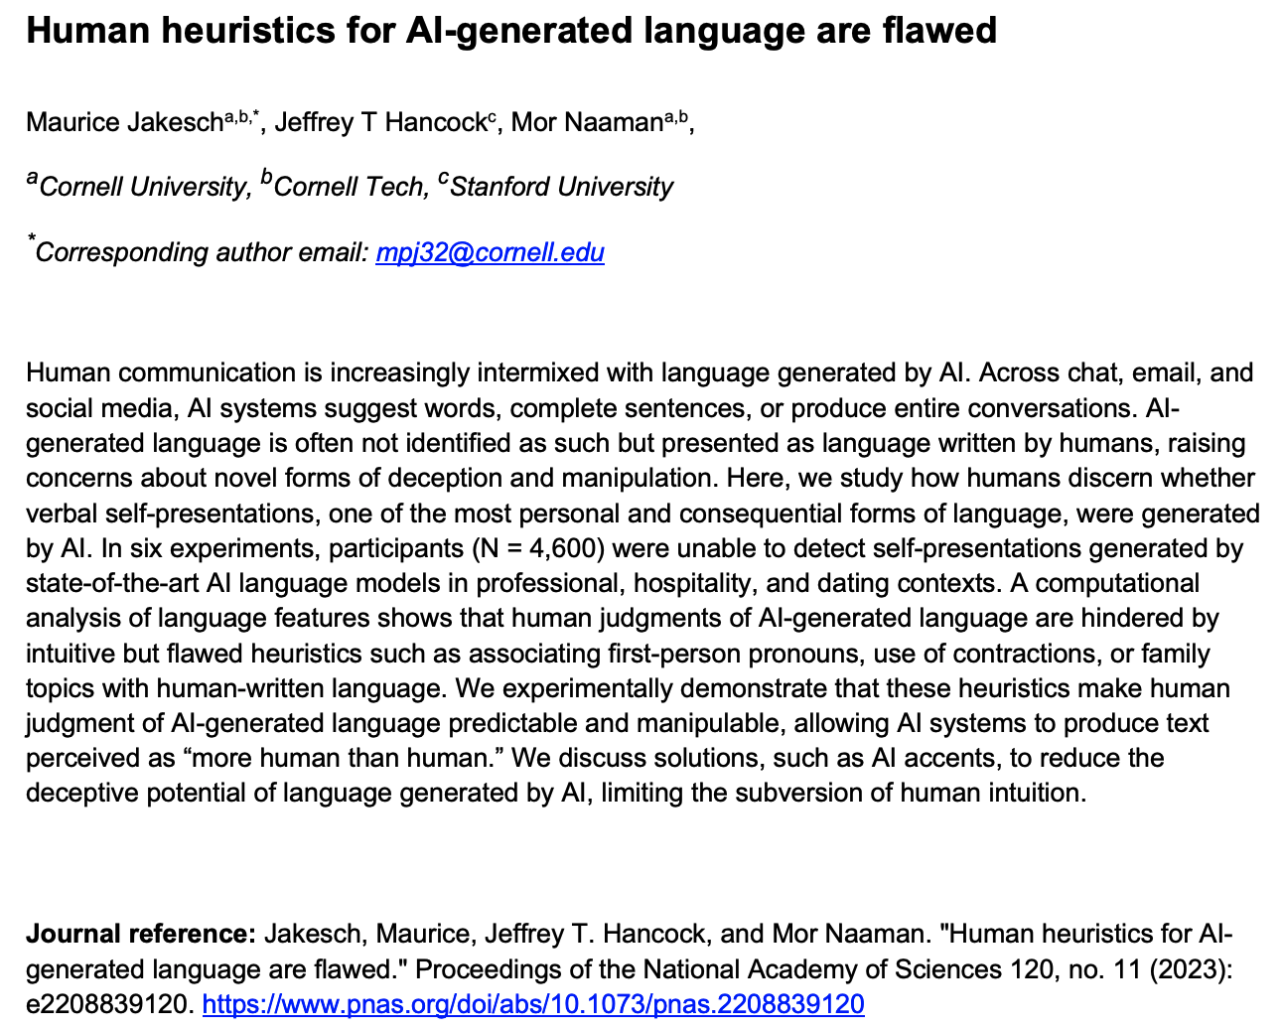
Humans have trouble recognizing LM generated content
Many reasons for wanting to identifying machine-generated content – e.g. to avoid using it as training examples for future language models
Humans are not good at detecting machine-generated content – can we hope that discriminative models will exhibit “super-human” performance on this task?
Notes:
Before we go into ML-based detection of generated content, you might wonder if humans are able to reliably do so. As it turns out, there is some evidence to the contrary. Researchers at Cornell and Stanford studied whether people are able to distinguish between human- and AI-generated content. The study involved 4,600 participants, which were given pairs of self-presentations (such as the description of one’s self on Linkedin or on a dating app), and were asked to decide which one was written by a person and which by an AI. The accuracy of the test subjects was close to chance; however, the inter-rater agreement (multiple subjects agreeing on what label to attach to a self-description) was significant, suggesting that people employ shared but flawed heuristics for identifying machine-generated content. That by itself is not an issue; there are many tasks where AI exhibits superhuman performance. So, the question is whether we can identify some form of “signature” of machine-generated content.

Slide 57
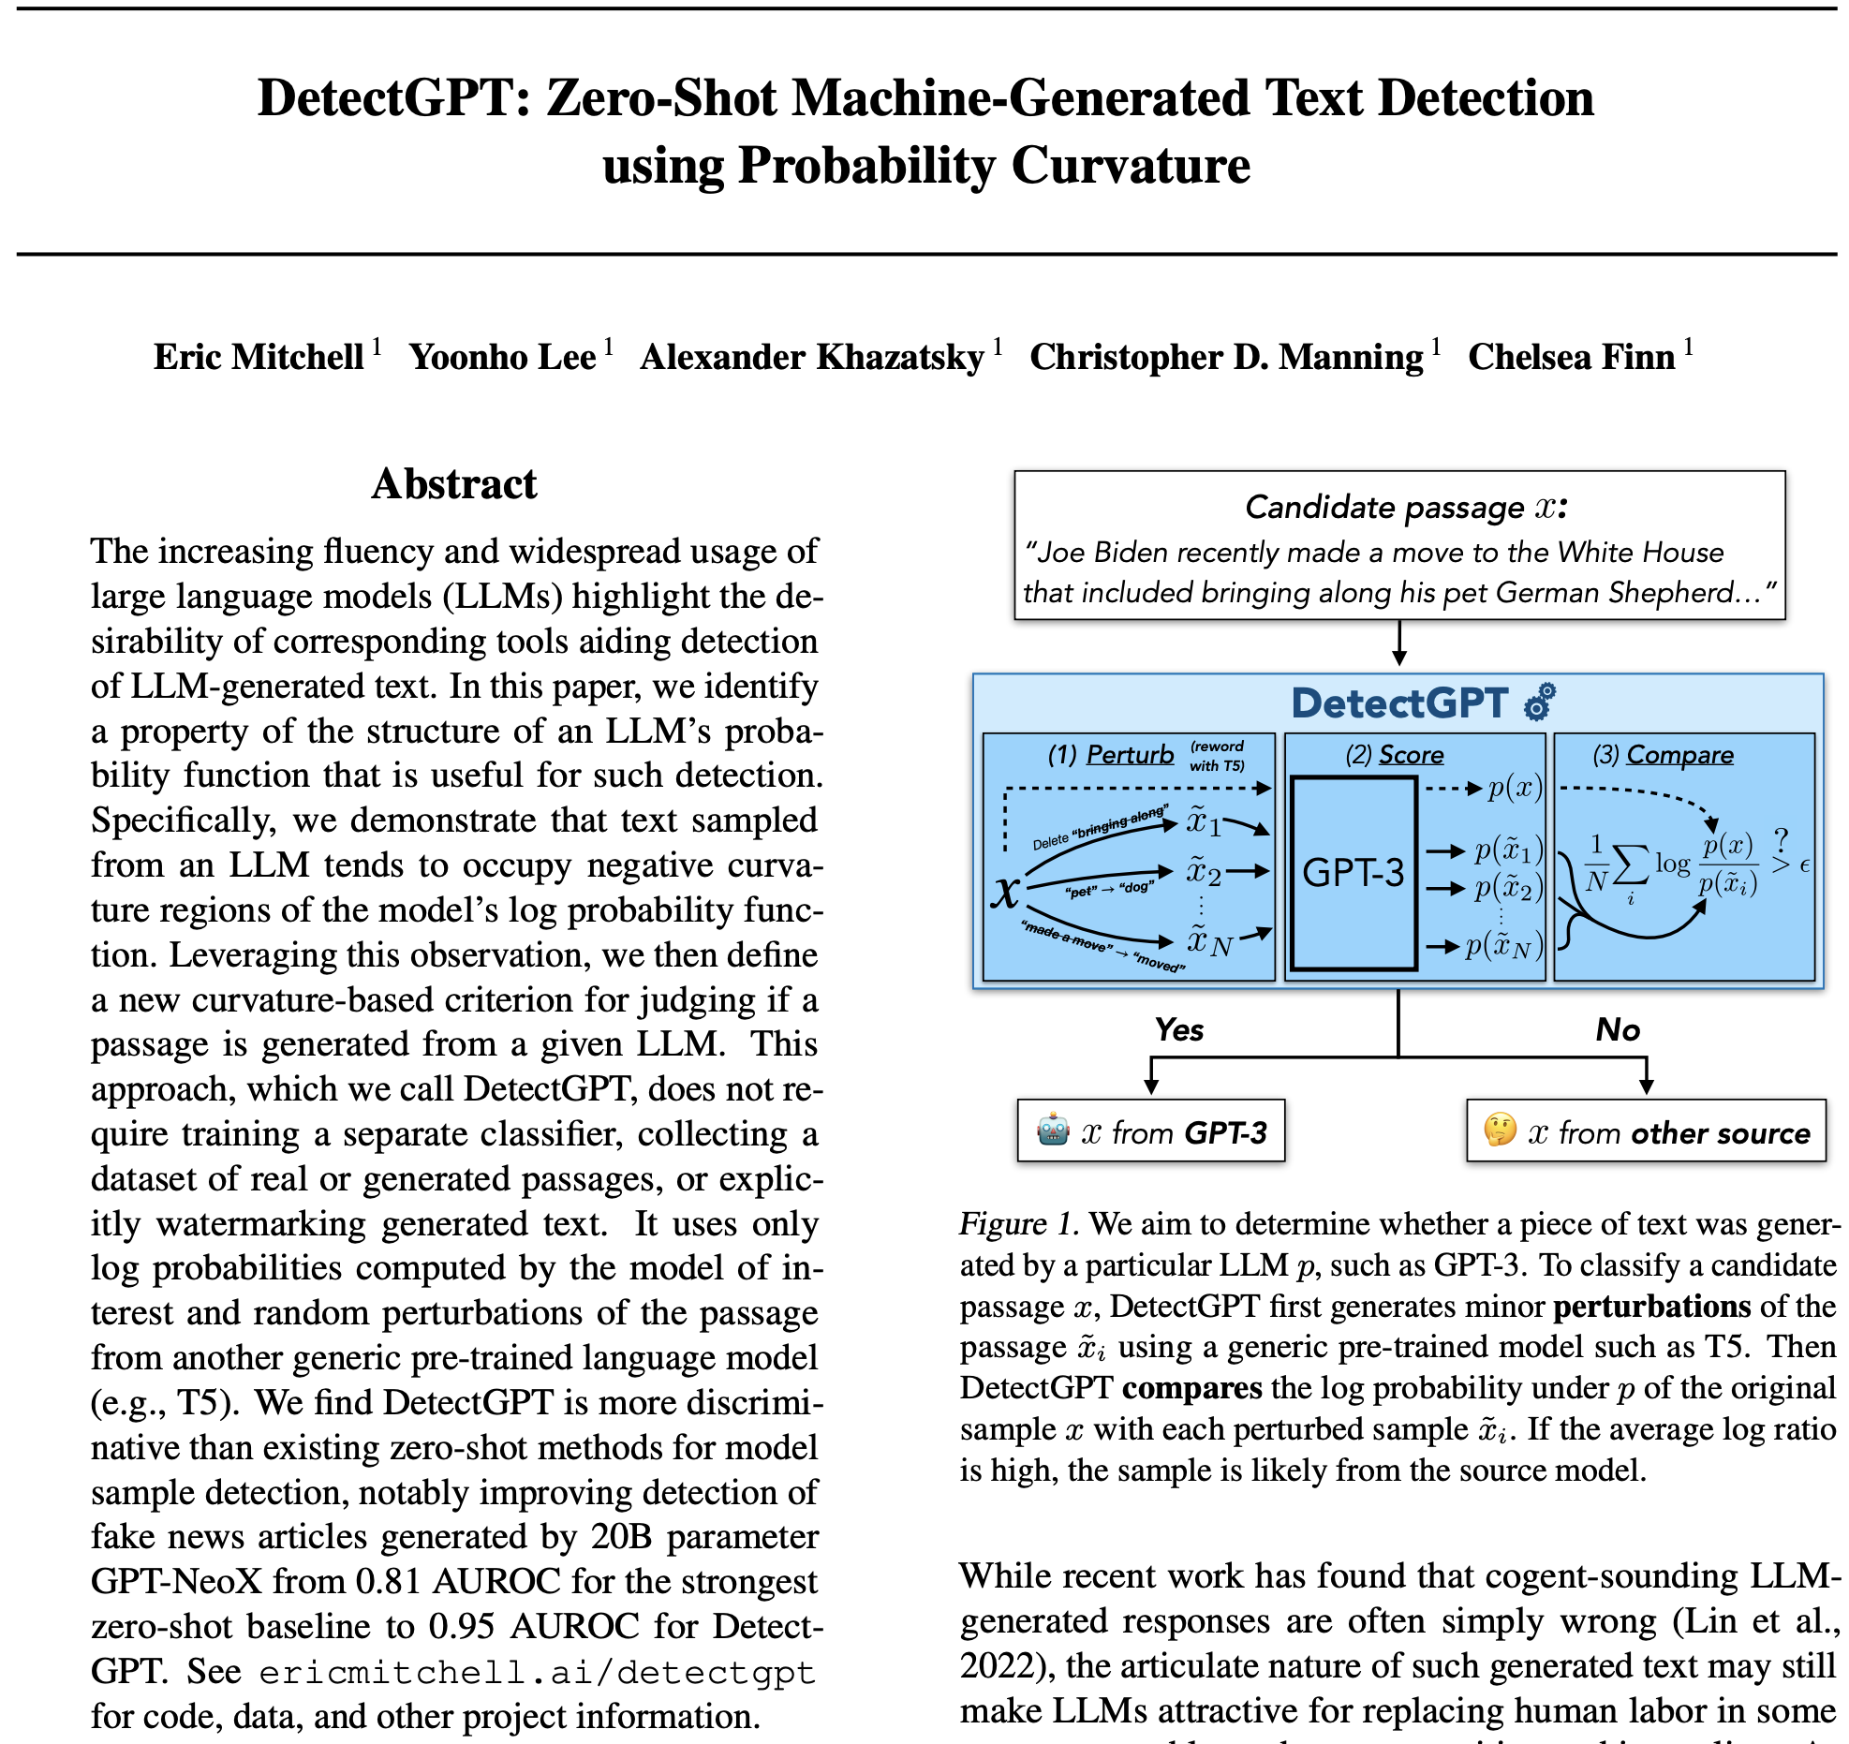
Detecting generated content
Each generation of generative language model spawns a set of detectors for such content – a classic “arms race” scenario
DetectGPT: a “white-box” detector for generated content, assuming that models generate the most likely text
Requires log likelihood of given text under model (e.g. through a scoring API). Perturbs text (using e.g. T5), compares log probabilities
Works if there are few models trained by cooperative parties; not realistic if there is a proliferation of “rogue” models without scoring APIs
PMLR 2023, https://proceedings.mlr.press/v202/mitchell23a.html
Notes:
There have been numerous stabs at this problem of detecting machine-generated content. In fact, there are commercial tools such as ZeroGPT and Originality.ai for detecting GPT-generated content. But how do you generalize detection to more than one family of generators? Researchers at Stanford have developed a technique that is based on the assumption that a generator (let’s call it G) produce text that is most likely under G’s model. Slight perturbations of generated text will be less likely under G’s model, whereas slight perturbations of text from a different source (such as a human) may be more or less likely under G’s model. So, if we have a way to determine the log likelihood of a piece of text under G’s model (for example by calling a scoring API provided by G), we have a test protocol: given a text T, compare T’s log likelihood to that of many perturbations of T. The approach works in a world where all providers of large models are responsible and cooperative. It breaks down if there is a proliferation of “rogue” models without a scoring API; and it is not robust to counter-measures (for example, the adversary perturbing the generated text)

Slide 58
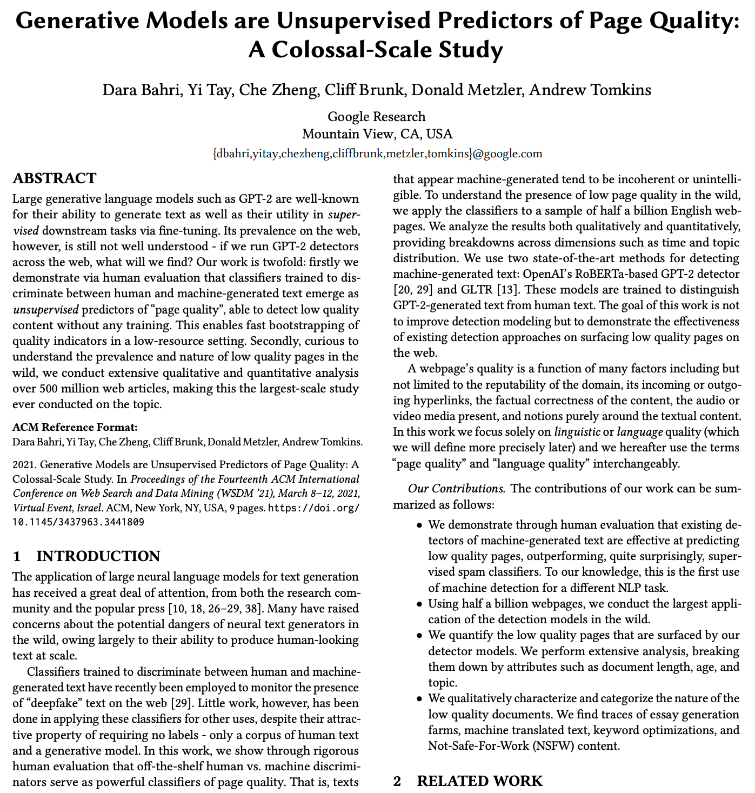
Can content quality be used to detect generated content?
2021 study by Bahri et al scoured 500 million page CommonCrawl corpus for generated content, using detectors fine-tuned for GPT-2
Found that these detectors are also suitable for detecting low-quality pages
Not clear if these results hold for newer generative models such as GPT-4 or PaLM 2. If so, could language quality be used as a signal to detect “rogue” generative models?
WSDM 2021, https://doi.org/10.1145/3437963.3441809
Notes:
In a 2021 study, colleagues at Google studied the correlation between generated content and low-quality content. They trained two detectors to detect GPT-2 content, and then applied these detectors to a 500 million page subset of the CommonCrawl corpus. They found that these detectors for machine-generated content were also predictors of page quality, or more precisely, of how how correct and fluent the prose on a web page is. Generative language models have come a long way since GPT-2, and it is not clear if these findings also apply to GPT-4 or PaLM 2. If they do, would it be possible to use language quality as a predictive feature for detecting generated content, to identify and flag content generated by “rogue” models that we don’t have white-box access to?

Slide 59
How will Direct Answers affect referral traffic?
Content creators/providers bundle content that is valuable to the reader with monetization vectors, such as ads, affiliate links, product placement, donation requests, freemium models, licensing, loyalty enhancers, etc
Many creators of free web content rely on search referral traffic to support their efforts
The pessimistic view: Direct answers reduce referrals to content providers, hurting their ability to monetize
The optimistic view: Attribution in direct answers will lead to higher-quality referrals that in aggregate are more valuable
The realistic view: Expect diversified business models and revenue streams
Notes:
Many content creators rely on “content bundling”: they draw users to their web site by offering content that is valuable to the user, and in the process also provide the user with content that provides value to the content provider – for example advertisements, or product placement, or e-commerce affiliate links, or Patreon-style donation requests, or freemium business models where free content is paired with premium content, and several other models. As mentioned a few slides earlier, if search engines answer more questions directly, this will reduce referral traffic to content creators. If the traffic that was cut off is low-quality – users who are unlikely to act on the bundled content, then this is not much of a problem. In fact, if search engines manage to provide more relevant referrals, then the aggregate value of the traffic may even increase. Realistically speaking, I believe that content creators will increasingly rely on multiple revenue streams, not all of them advertisement-based. There is limited academic research on this subject, which in my opinion is a lost opportunity, since there are many meaty technical problems hiding below the surface.

Slide 60
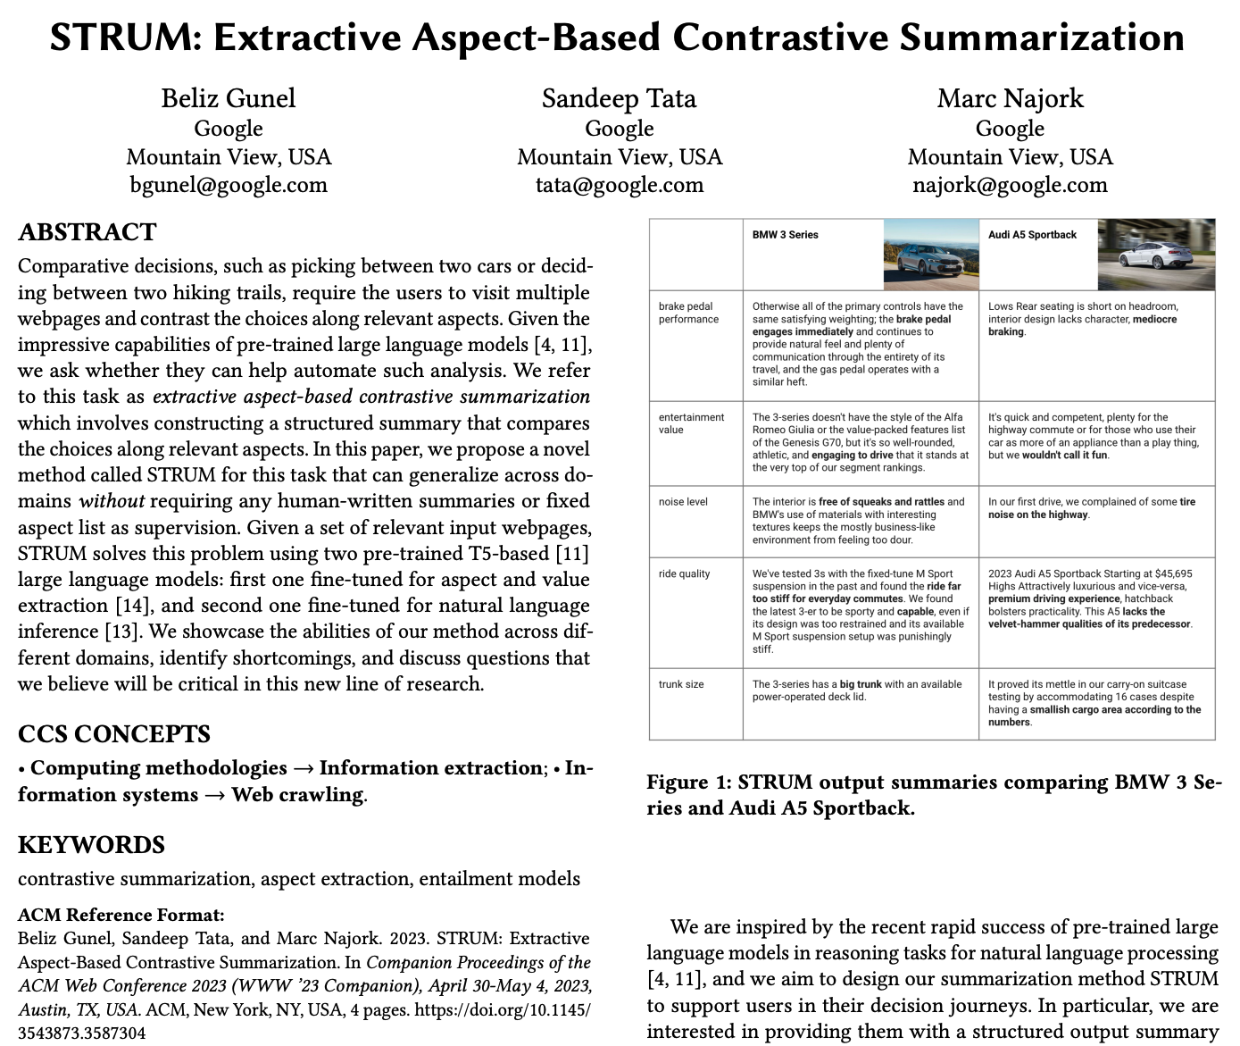
Better support of decision-making journeys
Example of better support for purchasing journeys: product comparisons
Learn the interesting facets of a product category
Extract facet values for each product
For a given pair of products, contrast the most relevant facets
WSDM 2023 Companion, https://doi.org/10.1145/3543873.3587304
Notes:
Finally, I suggested that search engines may be able to increase their overall value construction to users and to the ecosystem by focusing on the entire information-seeking journey rather than point solutions. Here is an example of supporting a particular journey: comparing two alternative choices across all the dimensions that are relevant to the user and where two alternatives differ in meaningful ways. The alternatives could be products, or services, or experiences, or even ballot initiatives. We prototyped a system called STRUM that automatically identifies all the relevant facets for a given product category, extracts the corresponding facet values for each product from available sources, and presents the user with the most relevant facets where the two products differ in meaningful ways. For more details, please read the paper. This is just one example of providing deeper support on a journey that may last for a longer period of time and potentially may culminate in a transaction.

Slide 61
Key Takeaway Points
Notes:
Finally, let me conclude this talk by giving you a few key takeaway points

Slide 62
Four points to take away from this talk
Direct Answers lower the Delphic Cost of information seeking
Generative models are a key enabler for direct answers
Ability to fuse information from multiple sources into one answer
Great progress on grounding answers and attributing them to sources
Benchmarks are being developed
Longer term, systems will become more stateful
Remembering past interactions
Leveraging tools to go beyond information-seeking tasks
Classical Information Retrieval is not dead!
External memory (e.g. an index) remains indispensable
Semantic retrieval is a vibrant research area, lots of open problems
New frontiers on ranking for retrieval-augmented generation
Notes:
My first point is the following: Much of information retrieval research has been focused on lowering the Delphic Cost of the information-seeking process. Direct answers lower the Delphic Cost, and generative models greatly improve our ability to provide direct answers, because they enable us to fuse information from multiple source documents into a single answer.
Secondly, there has been great progress on grounding answer and attributing them source documents, and benchmarks are emerging to measure progress on these fronts.
Third, looking at the future of question answering systems, these systems will become more stateful. They will support multi-turn interactions, they will support you on prolonged journeys, and they will be able to interact with other systems – both first-party and third-party.
Finally, and most importantly, classical information retrieval is not dead! Generative systems will continue to rely on external memory, including classical and neural retrieval systems. Semantic retrieval is a vibrant research area, there are lots of open research problems. And many classical IR problems should be reexamined will retrieval-augmented generation in mind. For example, retrieval augmented systems benefit much more from a diverse set of results that from precision at 1. Similarly, passage extraction now serves to provide the most useful prompt, not to enable the user to quickly skip over irrelevant results.

Slide 63
Time for Questions
Notes:
And with that, I am open for questions

